Slide 1

Intervention Programming from Beginning to End: Matching, Mapping, Monitoring, and Meeting
Clayton R. Cook, PhD
Associate Professor
School Psychology
College of Education & Human Development
University of Minnesota
Core Faculty
Institute for Translational Research in Children’s Mental Health
University of Minnesota

Slide 2
The Plan for this Presentation
Discuss how IM4 fits within a multi-tiered system of support (MTSS) and supports educators to deliver evidence-based interventions for students who need additional support
Describe each of the key steps of the IM4 process that enables effective intervention programming from beginning to end
Discuss Tier 2 and 3 interventions that can be tailored to students based on a root cause analysis

Slide 3

Welcome to IM4 , a problem-solving system that coordinates intervention programming from beginning to end for students with social, emotional, and behavioral needs.
Notes:
IM4 is somewhat similar to Turbotax. How many of you have used Turbotax to file your taxes?
Turbotax is a system that enables someone to perform like an expert accountant due to embedded algorithms and sequenced process. As a user, you need to prepared with specific information that it will prompt you to input into the system so you too can file you taxes in a way where you get maximum benefit and don’t violate IRS.
If you input the right information into the system, it will guide

Slide 4
What makes a behavior a problem?

Slide 5

Review of MTSS Basics
MTSS is the “operating system” – programs / practices / policies can all be “run” within it
A continuous improvement framework for incrementally improving the selection and delivery of supports to ensure that all students receive the supports they need to be successful
Equity-based, needs driven framework

Slide 6
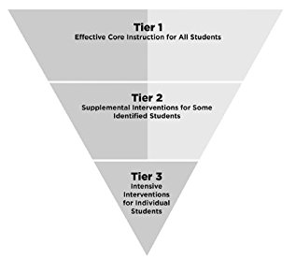
Purpose of Tier 1
Prevent problems from emerging
Promote/enhance/
optimize success
Provide a solid foundation that enable interventions to work better
ALL Students Receive Supports to Prevent and Promote

Slide 7
How does a student go from Tier 1 to Tier 2 or 3?
Proactive detection of students who may be in need of intervention
Use of existing data capturing warning indicators (“kitchen sink”)
Universal and/or targeted screening
Structured Teacher Nomination

Slide 8
Existing Social, Emotional, and Behavior Screening Tools
Free screening tools
  Student Risk Screening Scale (Externalizing & Internalizing)
  Brief Externalizing and Internalizing Screener for Youth (BEISY)
  Youth Internalizing & Externalizing Problem Screeners (YIPS & YEP)
  Strengths and Difficulties Questionnaire (SDQ)
Commercially available screening tools
  Social, Academic, Emotional Behavior Risk Screener (SAEBRS; FBL)
  Systematic Screener for Behavioral Disorders (SSBD)
  Behavior and Emotional Screening Scale (BASC)
  Social Skills Improvement System – Screener (SSIS-S)
  DESSA-Mini
  Review360 (Student internalizing behavior screener & Student externalizing behavior screener)

Slide 9
How does a student go from Tier 1 to Tier 2?
Site Intervention Team reviews detection data to:
First, ‘rule-in’ or ‘rule-out’ students who need additional intervention
Second, for students who are ‘ruled-in’, initiate a formal intervention process (e.g., IM4)

Slide 10
What is Tier 2?
10 to 20% of all students who:
  Have socially, emotionally and/or behaviorally needs that necessitate intervention above Tier 1 alone
  Quick and efficient
    Limited assessment data and minimal expertise needed to select an appropriate intervention for the student

Slide 11
Tier 2 is a protocol/process/system
Tier 2 is a coordinated process that we wrap around a child not just an intervention
  Proactively detecting students who need intervention
  Matching students to intervention
  Gathering baseline data
  Implementing the intervention
  Monitoring progress
  Meeting

Slide 12
Tier 2 problem-solving process
Step 1: Identify and define the main problem/concern/need
What intervention does the student need to address the hypothesized root cause underlying the problem?
Step 4: Evaluate whether the plan worked
Step 2: Determine why the problem is happening to generate solutions
Step 3: Develop and implement a plan

Slide 13

Who is responsible?
A multi-disciplinary team is responsible for the generating and implementing the solution

Slide 14
How to organize this process?
Problem-solving team that is activated for students who are detected as having a need that goes above and beyond Tier 1 alone
Formal process of selecting, planning, delivering, and monitoring of the impact of interventions
  Match, map, monitor, and meet

Slide 15
Intervention Programming from Beginning to End: Intervention Match, Map, Monitor and Meet (IM4)
Match
  Match the student to the most precise and appropriate intervention
Map
  Map out who is implementing core components of the intervention to increase the fidelity with which the intervention is implemented
Monitor
  Gather baseline data and begin monitoring student response to the intervention and intervention fidelity
Meet
  Meet as a team to review data and make a data-driven decision

Slide 16


Slide 17
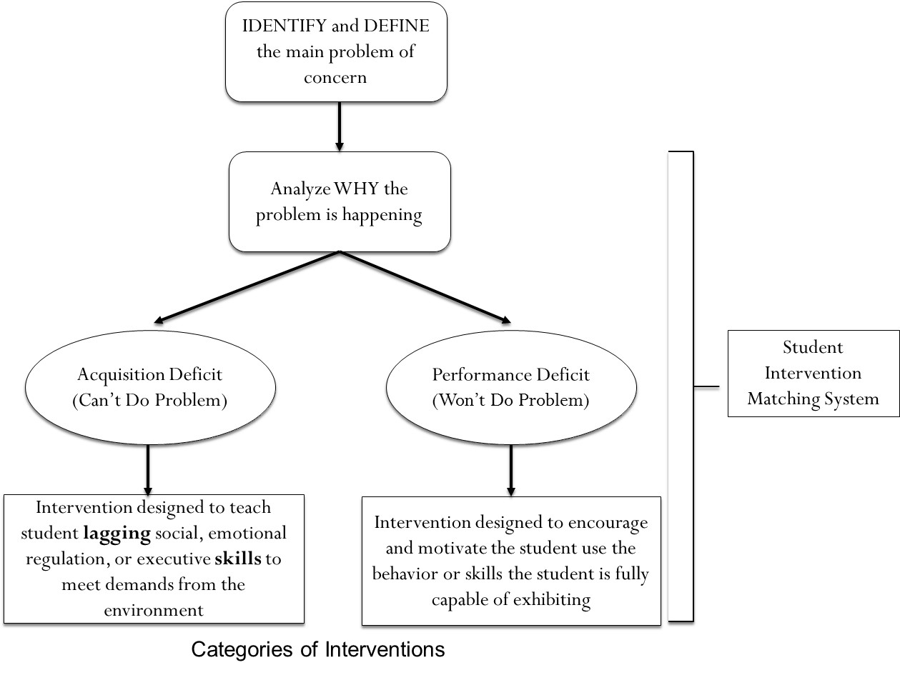
Match
  Match the student to the most precise and appropriate intervention

Slide 18
Problem-Solving Process
Step 1: Identify & define the problem
Step 2: Determine why the problem is happening (i.e., root cause analysis)
Step 3: Select an intervention to address the problem
Step 4: Implement the intervention with fidelity and determine whether it was effective
Student Intervention
Matching System

Slide 19



Root Cause Analysis
Theoretically-informed, data-driven approach to determine the hypothesized root cause that explains why the problem is happening
Linking root cause to intervention
  root cause must be amenable to intervention (malleable/alterable) so it can be linked to a precise intervention that educators have ability/control over to implement

Slide 20

Why a menu of evidence-based interventions?
Students with social, emotional and behavioral problems are a heterogeneous group of students
One-size-fits-all approach to intervention results in lackluster outcomes
Matching students to the most precise intervention requires having a menu of options to select from

Slide 21

Acquisition-Performance Deficit Paradigm
A problem or difficulty will always be observed when
(1) a person lacks or does not possess a skill or given set of behaviors
ACQUISITION DEFICIT
(Can’t do)
(2) A person is not properly supported or motivated to exhibit the skills or behaviors they do possess
PERFORMANCE DEFICIT
(Won’t do)
OR
to meet the demands and expectations of a given performance setting (e.g., classroom).

Slide 22
Acquisition vs. Performance
Descriptor | Acquisition Deficit | Performance Deficit
Explanation of the problem | Problem occurs because the student does not possess the requisite skills/behaviors to meet the demands or expectations of the environment | Problem occurs because the student is insufficiently supported or motivated by the environment to exhibit the skills/behaviors they possess
Student deficit | Student lacks a skill/behavior that is necessary to meet the social or academic demands of the environment | Student is not properly motivated and/or supported to utilize skills/behaviors they already possess
Type of problem | Can’t Do Problem (Skill) | Won’t Do Problem (Will)
Focus of the intervention | Instructional intervention that focuses on teaching the student lagging skills or behaviors to effectively meet the demands from the environment | Intervention that is embedded in the environment that prompts, encourages, and motivates student to use skills/behaviors he or she already possesses
Notes:
Students who are in the middle need more practice; to build their fluency
For behavior kids, treat kids who need fluency as kids who need acquisition→ gives opportunities for practice
Academically, it is easier to contrive practice situations
Performance deficit interventions need to be firmly embedded in the environment

Slide 23
Categories of Interventions
IDENTIFY and DEFINE the main problem of concern
Analyze WHY the problem is happening
Acquisition Deficit
(Can’t Do Problem)
Performance Deficit
(Won’t Do Problem)
Student Intervention Matching System
Intervention designed to teach student lagging social, emotional regulation, or executive skills to meet demands from the environment
Intervention designed to encourage and motivate the student use the behavior or skills the student is fully capable of exhibiting

Slide 24
Student Intervention Matching - Form

Slide 25

Tier 2 Menu of Supports
Tier 2 Menu:
Performance-based Interventions
  Behavioral contract
  Self monitoring
  School-home note system
  Structured, mentor-based program
  Class Pass Intervention
  Goal setting with problem solving
Acquisition-based Interventions
  Small group social-emotional skills
    Social skills
    Executive functioning
    Emotion regulation
Targeted/
Intensive
(A FEW
students)
Individual
Interventions
(3-5%)
Tier 2 Menu:
Performance-based Interventions
  Behavioral contract
  Self monitoring
  School-home note system
  Structured, mentor-based program
  Class Pass Intervention
  Goal setting with problem solving
Acquisition-based Interventions
  Small group social-emotional skills
    Social skills
    Executive functioning
    Emotion regulation
Selected
(SOME Students)
Small Group or
Individual Strategies
(10-25% of students)
Universal
(ALL Students)
School/classwide, Culturally Relevant
Systems of Support
(75-90% of students)

Slide 26
Example Evidence-based Performance- and Acquisition-Based Tier 2 Interventions
Performance-based Intervention
Acquisition-based Intervention
Structured School-based Mentoring
  e.g., Check in/Check out
Behavior contracting
Class Pass Intervention
Self-monitoring
School-home note system
Traditional social skills training
Emotion Regulation
  Anxiety
  Anger
  Trauma
Executive functioning
  Organization
  Impulse control
  Attention regulation

Slide 27


Performance-Based Intervention
Behavior Contract
Process of negotiating an agreement between staff and a student so each party receives some benefit or payoff
  Teacher benefits by improved student behavior
  Student benefits by earning something based on good behavior
Components of behavioral contract:
  Description of the desired behaviors
  Goal statement specifying by when, what behavior, and under what conditions pay-off will be earned
  Identification of the privileges, rewards, or desired social experiences to be earned
  (i.e., The Pay-Off)
  Signatures from all parties involved
  Teacher precorrects and prompts student on daily basis using the behavior contract

Slide 28

Behavior Contract:
Student Characteristics
Designed for students who respond well to school-based incentives or contingent access
  Eager to earn rewards, special privileges, and/or recognition from others
Students who dislike particular academic subjects and could benefit from receiving extrinsic reinforcement (i.e., pay-off)
Students who could benefit from receiving precorrection and prompting

Slide 29

Behavior Contract:
Active Ingredients
Negotiated agreement or brokered deal to increase student buy-in
Focus on positive behaviors teachers want to see in the classroom (i.e., those behaviors that are incompatible with problem behavior)
Positive reinforcement for meeting goal
Teacher follows up with daily pre-correction and prompting
  Pulling out the contract and reminding the student of the behavior and reward to be earned
  At the first warning signs of problem behavior, prompting the student

Slide 30
Difference Between Effective and Ineffective Behavior Contracts
Negotiated agreement
Describes what the student should do
Provides a goal statement
Outlines what the student will earn as a reward for meeting goal
Teacher uses contract to precorrect and prompt behavior
Non-negotiated
Describes what the student is doing wrong
Provides no goal statement
Outlines how the student will be punished if problem behavior continues
No other adult follow through with the contract
EFFECTIVE BEHAVIOR CONTRACT
INEFFECTIVE BEHAVIOR CONTRACT

Slide 31
Performance-Based Intervention
Daily Structured Mentoring (e.g., Check-in/Check-out)
Assignment of a mentor who provides unconditional positive regard and bookends support on the front- and back-end of each day
  Avoid a person who has a dual relationship with the student (e.g., mentor and the teacher)
Active ingredients of behavior change:
  Behavioral momentum (i.e., getting the day off to a good start)
  Precorrection (i.e., cutting problems off before they start)
  Performance feedback (i.e., letting the student know how s/he is doing)
  Positive reinforcement (i.e., recognizing and rewarding the student)
  Goal specification and attainment (i.e., increasing student’s motivation and awareness of behavior)

Slide 32
Simple vs. Structured Mentoring
Mentor meets with the child infrequently
Mentor is there to be a positive role model with limited to no precorrection
Often no target behaviors identified to address
Can handle significantly more students
Mentor meets with the child on a daily basis
In addition to positive relationship, mentor precorrects problem behavior
Daily ratings of specific targets behaviors
Limitations with regard to the number of students a school can handle
SIMPLE MENTORING
DAILY STRUCTURED MENTORING

Slide 33
Mentor-Based Support
Basic Sequence of Structured Mentoring
Positive greeting
Check for school readiness
Cutoff problems before
Reminder of expected behaviors
Talk about reward to be earned
Give student monitoring chart
Deliver consequences at home based on behavior at school
Provide encouragement for a better day tomorrow
Morning check in with mentor
Positive greeting
Deliver praise/reward
Provide nonjudgmental feedback
Parent Check In upon arrival home
Teacher evaluation and ongoing feedback
Teacher monitoring
Prompts to engage in expected behavior
Reminder of reward to be earned
End of day check out with mentor

Slide 34
Mentor-Based Support:
Student Characteristics
Students who respond well to adult attention
Students who could benefit from having a positive adult role model outside of the home
Students who could benefit from receiving daily encouragement and feedback to improve behavior and school performance
Students who have been involved with negative interactions with teachers and administrators (punitive discipline)

Slide 35
Mentor-Based Support:
Active Ingredients
Assignment of an adult mentor who the student likes or doesn’t mind meeting with
Unconditional positive regard (mentor does not get involved with discipline)
Daily contact with the student in the morning and afternoon
  Encouragement, precorrecting problems, feedback
Progress monitoring form to serve as a basis for performance-based feedback
Positive reinforcement for improved behavior
  Praise, public recognition, access to desired privileges/rewards

Slide 36




Performance-Based Intervention
Self-Monitoring
Intervention designed to increase self-management by prompting the student to self-reflect and self-record specific behaviors on a chart/form
Two main components:
    Self-reflection (reflection of behavior over a certain amount of time)
    Self-recording (marking down on the chart whether behavior met or did not meet expectations)
Teacher performs periodic honesty checks

Slide 37
Self-Monitoring:
Student Characteristics
Students who needs constant prompts and reminders to stay on track
Students who experience difficulties with self-management / regulation
Students who exhibit relatively frequent rates of problem behavior
Students who could benefit from reminders or prompts to stay on task and engage in desired, expected behaviors

Slide 38
Self-Monitoring:
Active Ingredients
Identification of behaviors to self-reflect upon and self-record on a chart
Development of a self-monitoring chart that the students uses to record his/her behavior
Device or natural break that prompts the student to self-reflect and self-record behavior
Train the student (tell-show-do)
Positive reinforcement component attached to self-monitoring chart (increases the value or meaning of self-reflection and recording)
Teacher conducts periodic honesty check

Slide 39

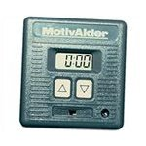
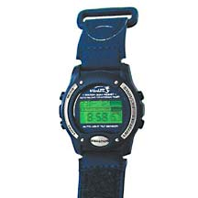


Self-Monitoring Technology

Slide 40
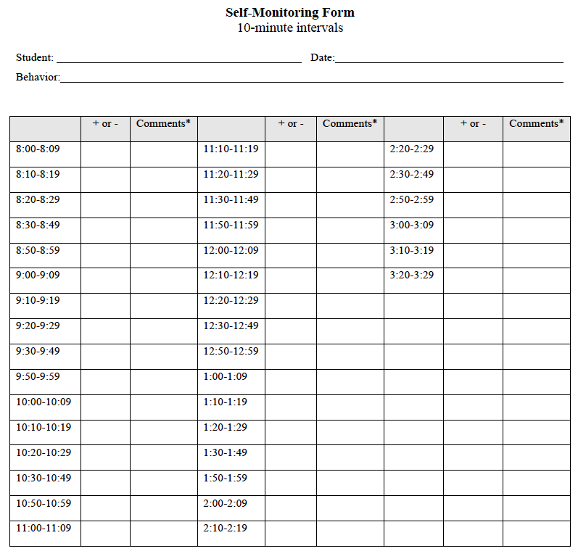

Slide 41
Performance-Based Intervention
School-Home Note System
Intervention designed to improve the communication and consistency of practices between school and home environments
Involves training parents to act upon a school behavioral note by delivering consequences at home consistent with their child’s behavior at school
Two-way communication - Parents can share information with school about outside stressors that may be impacting student behavior at school

Slide 42
School-Home Note Decision Tree
DAILY BEHAVIORAL GOAL
YES - GOAL MET
NO - GOAL UNMET
PARENT RESPONSE
CELEBRATE YOUR CHILD’S SUCCESS (positively reinforce)
ENCOURAGE YOUR CHILD TO HAVE A BETTER DAY TOMORROW
(effective discipline)

Slide 43
Consequences Delivered by Parents
Celebrating the child’s success to recognize and acknowledge behavioral goal being met
  Access to daily home-based privileges
    Computer time, video games, talking on the phone, staying up later, hanging out with friends, TV time
  Access to a reward or desired experiences
    Buy-out of chore, money, invite friend over, play outside, after dinner dessert, playing with toys, etc.
  Behavior specific praise and positive recognition

Slide 44
Consequences Delivered by Parents
Encouraging a better day tomorrow (effective discipline to teach)
  Loss of daily privileges
    Removal of TV time, computer, video games, playing outside, talking on the phone, or anything else that is considered to be fun
  Task-based grounding
    Have the child perform chores that are outside of typical responsibilities
    Grounded until the chore or chores are completed
  Collaborative problem-solving
    Debrief about the barriers and create mutually agreeable plan to overcome barrier to meet behavioral goal

Slide 45
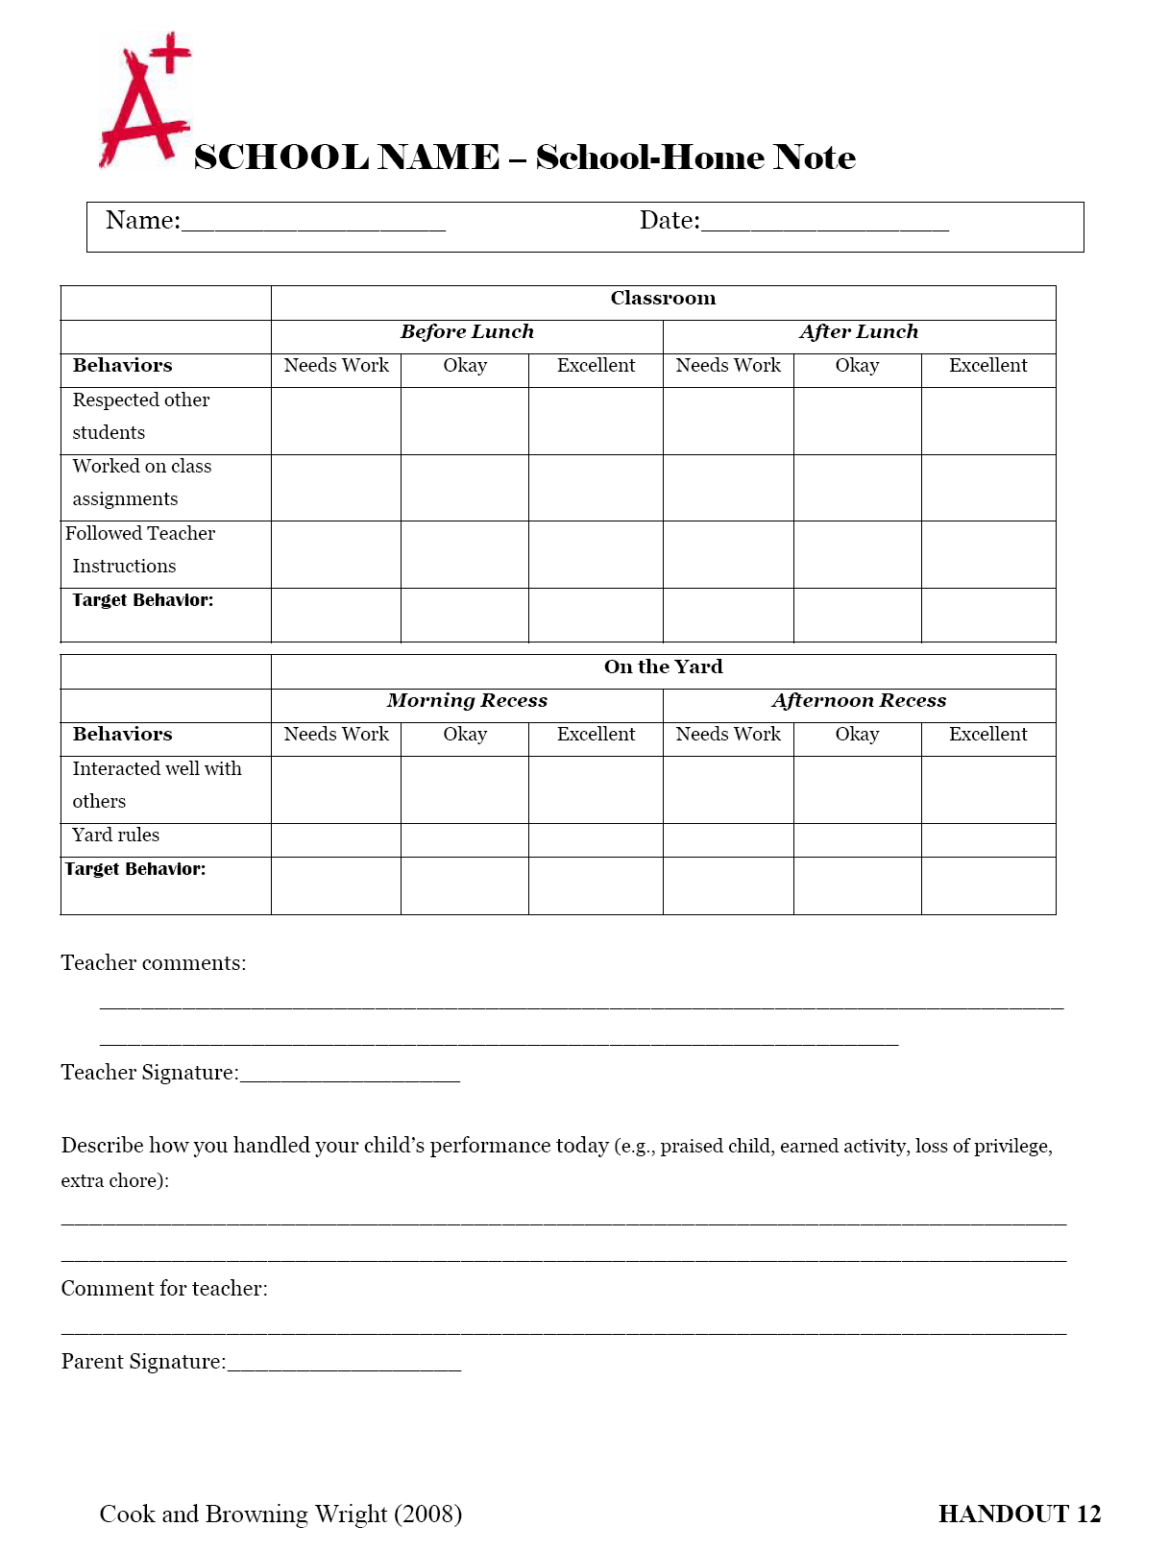

Slide 46
School-Home Note:
Student Characteristics
Students whose parents are open and willing to join forces with the school to improve the student’s performance in school
Students who are unaffected by typical school-based disciplinary consequences
Students whose parents could benefit from learning skills
Students who could benefit from consistency across school and home environments

Slide 47
School-Home Note:
Active Ingredients
Development of a school-home note that captures student behavior and communicates whether behavioral goal was met
  Student behavior section, teacher communication section, parent response to note section, parent communication section, & signatures
Brief parent training that consists of teaching parents how to translate the information on the school-home note into effective parenting strategies
  Goal met = celebrating success
  Goal unmet = encouraging a better day tomorrow
Ensuring that parents are receiving the note & following through
  Paper, email, phone call, face-to-face

Slide 48
Performance-Based Intervention
Class Pass Intervention
CLASS PASS
Name: ________________
Time: __________
Where to?: ___________________
Initial: __________
Intervention designed for students who escaped-motivated disruptive classroom behavior
Students are given class passes and taught how to appropriately request a break by issuing a class pass
Students can choose to hold on to the class passes to exchange them for a more preferred item, activity, or privilege
It works because students:
  Exercise choice by requesting a break with class pass
  Dual motivational contingencies (break from work and contingent access to preferred experience)

Slide 49
CPI Implementation Steps
Meet with the student to teach them the CPI and how to appropriately request a break using the class pass
Identify a spot where the student can break and engage in a preferred activity for 3 – 7 minutes (this depends on how long staff are willing to accept)
Determine the rewards and/or privileges that can be earned by saving the class passes (make it such that the more passes means the better the reward and/or privilege)
Give the student a predetermined amount of class passes (anywhere from 3 to 5)
When implementing the CPI, provide prompts to the student to use the class pass if you see him beginning to engage in problem behavior
Monitor and track the effectiveness of the intervention
Give the student feedback about how he is doing

Slide 50
Class Pass Intervention:
Student Characteristics
Students who engage in classroom behavior problems only when presented with academic work
Students whose classroom behavior is hypothesized to be escape-motivated
Students who have a low tolerance for engaging in academic work
Students who are more likely to remain on-task when provided with choice

Slide 51
Class Pass Intervention:
Active Ingredients
Develop the actual class passes to be used
Determine the number of class passes and length of time the student can break for
Identify the location for the break (desk, in the classroom, outside of the classroom)
Identify the items, privileges, or activities that can be earned and the number of class passes needed for each one

Slide 52
Example of a Class Pass
FRONT
BACK
Guidelines for Class Pass:
If you use the pass…
1. Choose a time when you need to step out of the class.
2. Fill out one of your passes.
3. Show pass to teacher.
4. Walk to ____________________.
5. Have adult where you walked initial pass on your way back to class.
6. Enter class quietly.
7. Join classroom activity.
If you save the pass…
Earn a reward!!!!!!!
CLASS PASS
# ______
Name: ________________
Time: __________
Where to?: ___________________
Initial: __________
Reward for a saved pass:
___________________________

Slide 53
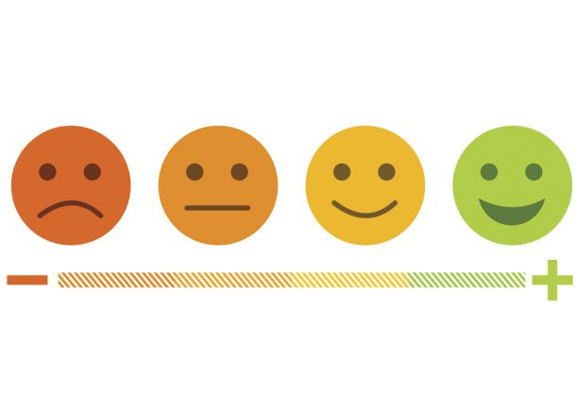

Acquisition-Based Interventions
EMOTIONAL REGULATION/COPING
  Anger
  Anxiety
  Trauma
  Stress/Depression
BEHAVIORAL REGULATION
  Social Skills
  Executive Functioning

Slide 54
Example evidence-based curriculum
EMOTIONAL REGULATION
  Anger
    Anger replacement training; Coping Power
  Anxiety
    FRIENDS, Coping Cat, Coping with Stress
  Trauma
    Bounce Back, Cognitive Behavior Intervention for Trauma in Schools
  Stress/Depression
    Coping with Depression, Penn Resilience Program, Teaching Kids to Cope
BEHAVIORAL REGULATION
  Social Skills
    Skillstreaming, Social Skills Improvement System
  Executive Functioning
    Homework, Organization, and Planning Skills

Slide 55


Slide 56
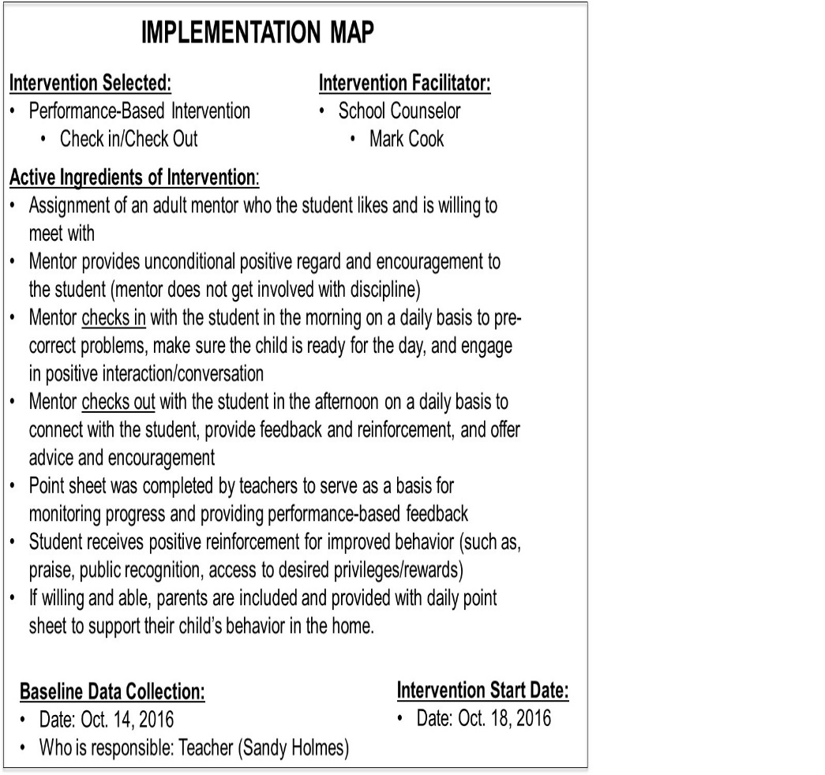
Map
Map out who is implementing core components of the intervention to increase the fidelity with which the intervention is implemented

Slide 57




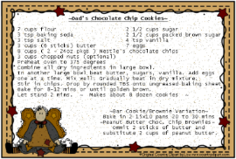

Mapping out a Plan (MAP)
Focusing on the Active Ingredients
Delivering an effective intervention is like a good cooking recipe that involves combining multiple ingredients to produce a yummy product
  An ingredient is a component of a product that helps achieve its desired outcome
  Single ingredients are necessary but insufficient alone to produce the desired outcome
=

Slide 58
IMPLEMENTATION MAP
Intervention Selected:
Performance-Based Intervention
  Check in/Check Out
Intervention Facilitator:
School Counselor
  Mark Cook
Who’s Responsible?
Active Ingredients of Intervention:
Assignment of an adult mentor who the student likes and is willing to meet with
Mentor provides unconditional positive regard and encouragement to the student (mentor does not get involved with discipline)
Mentor checks in with the student in the morning on a daily basis to pre-correct problems, make sure the child is ready for the day, and engage in positive interaction/conversation
Mentor checks out with the student in the afternoon on a daily basis to connect with the student, provide feedback and reinforcement, and offer advice and encouragement
Point sheet was completed by teachers to serve as a basis for monitoring progress and providing performance-based feedback
Student receives positive reinforcement for improved behavior (such as, praise, public recognition, access to desired privileges/rewards)
If willing and able, parents are included and provided with daily point sheet to support their child’s behavior in the home.
Initials:_______
Initials:_______
Initials:_______
Initials:_______
Initials:_______
Initials:_______
Initials:_______
Dates:
Baseline Data Collection:
Date: Oct. 14, 2016
Who’s responsible: Teacher (Sandy Holmes)
Intervention Start Date:
Date: Oct. 18, 2016
Meeting to Review Data Date:
Date: Nov. 2, 2016

Slide 59


Slide 60
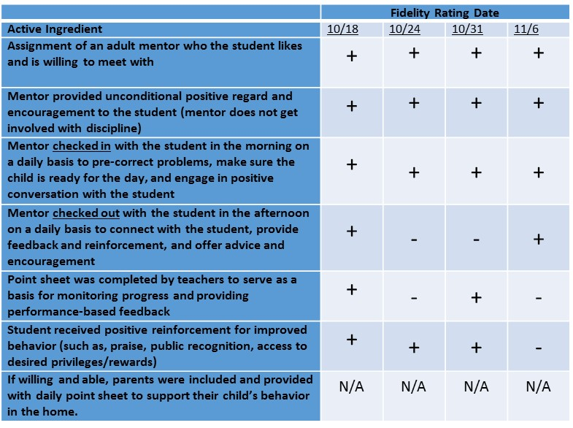
Monitor
  Gather baseline data and begin monitoring student response to the intervention and fidelity of implementation

Slide 61
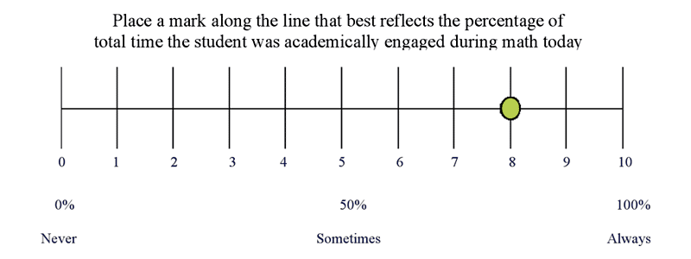
Advantages of Direct Behavior Rating
  Brief and valid
  Behaviors are explicitly defined and measure captures a key dimension of behavior (frequency, duration, intensity)
  Ratings are pre-set so students and adults can easily monitor behavior
  DBR is defensible, flexible, repeatable, and efficient
    Direct Behavior Rating Scale Example:
http://dbr.education.uconn.edu/
Notes:
61
Can be used as:
a means to assess and/or monitor student behavior
a component of an intervention
a tool through which to communicate obtained information to other individuals (e.g. parents, teachers, students)

Slide 62
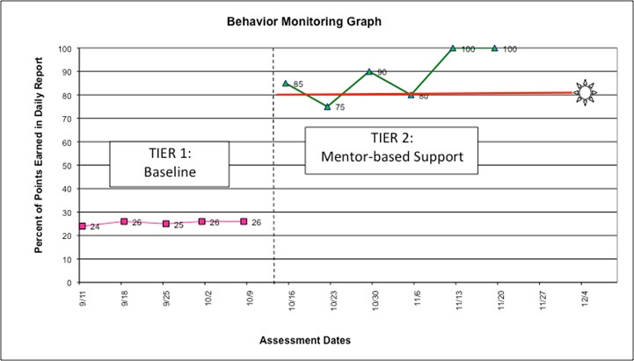

Slide 63
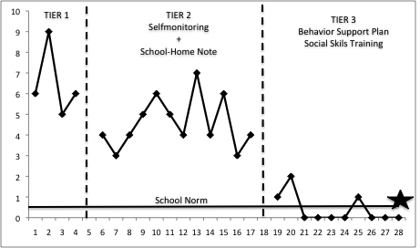

Slide 64
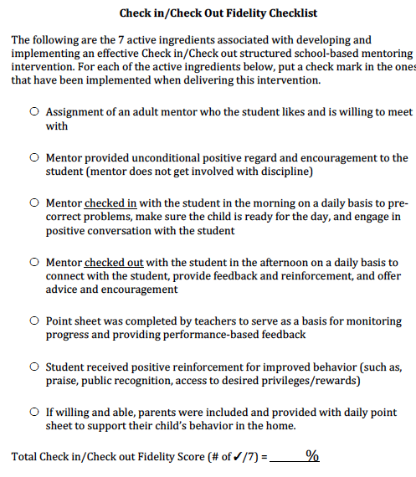
Monitoring Intervention Fidelity

Slide 65
 | Fidelity Rating Date
Active Ingredient | 10/18 | 10/24 | 10/31 | 11/6
Assignment of an adult mentor who the student likes and is willing to meet with | + | + | + | +
Mentor provided unconditional positive regard and encouragement to the student (mentor does not get involved with discipline) | + | + | + | -
Mentor checked in with the student in the morning on a daily basis to pre-correct problems, make sure the child is ready for the day, and engage in positive conversation with the student | + | + | + | -
Mentor checked out with the student in the afternoon on a daily basis to connect with the student, provide feedback and reinforcement, and offer advice and encouragement | + | - | - | -
Point sheet was completed by teachers to serve as a basis for monitoring progress and providing performance-based feedback | + | - | + | -
Student received positive reinforcement for improved behavior (such as, praise, public recognition, access to desired privileges/rewards) | + | + | + | -
If willing and able, parents were included and provided with daily point sheet to support their child’s behavior in the home. | N/A | N/A | N/A | N/A

Slide 66


Slide 67
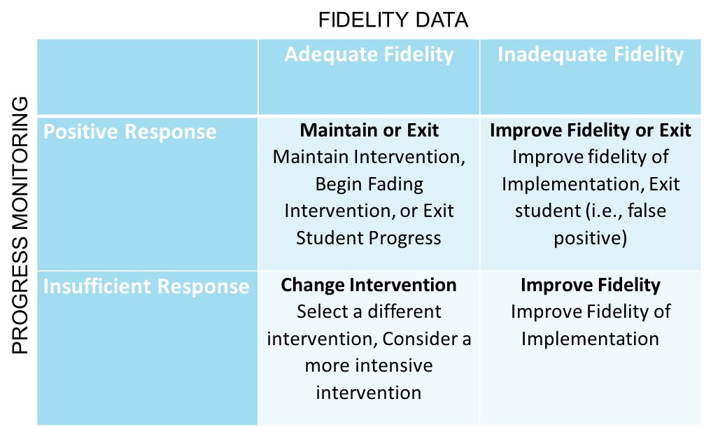
Meet
  Meet as a team to review data (graphed progress monitoring depicting student response and estimates of fidelity of implementation) and make timely and relevant data-driven decisions

Slide 68
Meeting Phase
Structured Teaming to Drive Data-Driven Actions
Schedule meeting prior to beginning the implementation of the intervention
Gather data while the intervention is being implemented
Prepare data to be consumed by team to drive a decision
Assign roles and create a structured agenda to ensure the meeting runs efficiently

Slide 69
Meeting to Make a Data-Driven
FIDELITY DATA
 | Adequate Fidelity | Inadequate Fidelity
Positive Response | Maintain or Exit Maintain Intervention, Begin Fading Intervention, or Exit Student Progress | Improve Fidelity or Exit Improve fidelity of Implementation, Exit student (i.e., false positive)
Insufficient Response | Change Intervention Select a different intervention, Consider a more intensive intervention | Improve Fidelity Improve Fidelity of Implementation
PROGRESS MONITORING

Slide 70



http://itr.umn.edu/
im4education.com
crcook@umn.edu
@ClayCook_PhD

