Slide 1
Intensifying Academic Interventions
Robin S. Codding, Ph.D., BCBA-D
rccodding@umn.edu

Slide 2
Overview
RtI & Intensity
Defining Intensity
Aspects of Strength & Supporting Evidence
Aspects of Complexity & Supporting Evidence
Application to Data-Based Decision Making

Slide 3
Responsiveness to Intervention
Yeaton and Sechrest (1981) suggested, “by monitoring strength, integrity, and effectiveness for the duration of treatment, we can make appropriate mid-course corrections…(p.156)”
Effectiveness
Integrity
Intensity
Notes:
student responsiveness to any intervention is predicated on a 3 legged stool. Effectiveness is impacted by the integrity with which the intervention is implemented (adherence and quality) and intensity

Slide 4

RtI Has Always Included Intensity, Right?
Tier 3:
Intensive
Interventions
Continuum of Time, Intensity and Data Increases
Percentage of Students Requiring Intensive Supports Decreases
Strategic Interventions
for
Students at Risk of Academic Failure
Tier 2:
Strategic and Targeted
Interventions
Tier I:
Benchmark and School Wide Interventions
Notes:
Implication > intense better the outcome for children with more academic deficits; in fact the institute for education sciences released a practice guide for implementation of RTI that includes a recommended Tier 2 services of 3-5 times/week for several weeks before more intensive daily is recommended (Gersten et al, 2009)
Importance of the layered support within RTI hinges on differentiation with intensity – despite this widely discussed conceptual idea little evidence exits examining intensity variables and as I will illustrate in a minute no clear definition of this construct
Barnett and colleagues (2004) suggested that technical adequacy relies on accurate decision rules b/w and within tiers and judging intervention intensity

Slide 5
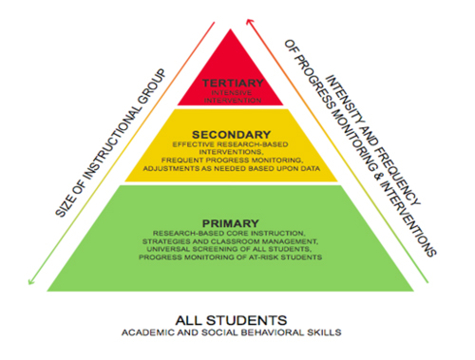
More Illustrations of RtI Intensity

Slide 6
Standard Protocol vs. Problem Solving Frameworks
(Gresham, 2007)
Tier 2
Tier 3
Standard Protocol
Theoretical Notion: Students have not been given adequate opportunities to learn
Goal: Provide research validated treatment protocols
Advantage: Better quality control of treatment delivery, more feasible and usable
Problem Solving Approach
Theoretical Notion: Identify environmental conditions related to REASON for individual student’s challenges
Goal:
Clearly define problem
Generate hypotheses for the REASON for the problem
Design an intervention accordingly & implement with integrity
Evaluate the effects
Advantage: Treatment may be better matched to reason for problem & is individualized

Slide 7
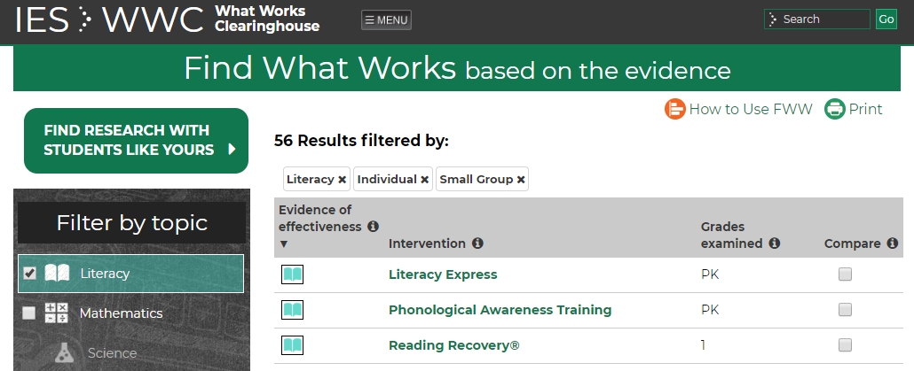
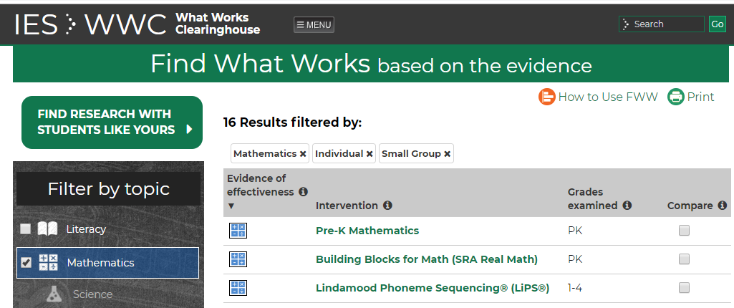
Reality of Standard Protocols
Select an intervention package with best available evidence
Notes:
Selecting an intervention with the best available evidence is only one aspect of maximizing the probability that students’ struggling in school are going to benefit from receiving targeted supports (Fixsen, Blasé, Duda, Naoom, & Van Dyke, 2010).
Not all children are responsive & not always an intervention package that is feasible usable and available

Slide 8
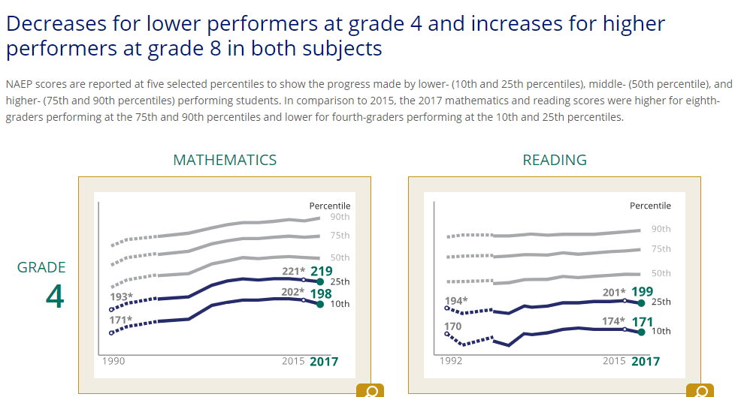
Reality of Standard Protocols
Failure to move the needle on students with most intensive needs
Notes:
standardized evidence-based treatment protocols do not address the needs of all students (e.g., Al Otaiba, Wagner, & Miller, 2014; Fuchs et al., 2008; Gilbert et al., 2013; Vaughn et al., 2010; Vaughn, Zumeta, Wanzek, Cook, & Klinger, 2014; Wanzek et al., 2016).

Slide 9
Standard RtI
Tier 1 + Screening
Primary Prevention
Tier 2 + Progress Monitoring
Secondary Prevention
Tier 3 + Progress Monitoring
Tertiary Prevention
Notes:
Students Progress through all stages – notably tier 2 is provided before tier 3

Slide 10
Dynamic RtI
Screening
Tier 1 + Progress Monitoring
Tier 2 + Progress Monitoring
Tier 3 + Progress Monitoring
Notes:
Students Progress through all stages – notably tier 2 is provided before tier 3
This randomized controlled experiment compared the efficacy of two response-to-intervention (RTI) models—typical RTI and dynamic RTI—and included 34 first-grade classrooms (n = 522 students) across 10 socioeconomically and culturally diverse schools. Typical RTI was designed to follow the two-stage RTI decision rules that wait to assess response to Tier 1 in many districts, whereas dynamic RTI provided Tier 2 or Tier 3 interventions immediately according to students’ initial screening results. Interventions were identical across conditions except for when intervention began. Reading assessments included letter-sound, word, passage reading, and teacher-reported severity of reading difficulties. An intent-to-treat analysis based on multilevel modeling indicated an overall effect favoring the dynamic RTI condition (d = .36); growth curve analyses demonstrated that students in dynamic RTI showed an immediate score advantage and that effects accumulated across the year. Analyses of standard score outcomes confirmed that students in the dynamic condition who received Tier 2 and Tier 3 ended the study with significantly higher reading performances than students in the typical condition. Implications for RTI implementation practice and future research are discussed

Slide 11
SMART RtI Continued…
“Determining individual students’ needs for highly intensive intervention before placing them in low intensity Tier 2 intervention may be the most cost-effective approach and…more ethical than placing students in low-intensity interventions that are likely to be ineffective…” (Vaughn et al., 2010, p. 442).

Slide 12
Solution: Problem Solving Steps
Define Problem
Analyze Problem
Actions Steps: What to do?
Implement Treatment
Evaluate Progress

Slide 13
SMART RtI
The Level of Intensity Offered in Primary & Secondary Prevention Levels Is Insufficient to Meet the Needs of a Significant Minority of Students
Notes:
Okay – yes we know this that is why we have tier 3….but

Slide 14
What is Intensity?
(Gresham, 1991; Warren, Fey, Yoder, 2007)
Quality of Services
Quantity
of Services
Treatment Intensity
Notes:
Definition of this construct is relatively illusive…delivered in a given time;
Gresham (1991) – a given intervention will change a problem situation;
Implication > intense better the outcome

Slide 15
Treatment Intensity - #1
(Torgesen, 2005)
Time Allocated
Group Size
60 Min
30 Min
15 Min
6-10
3-6
1-2
Notes:
Mellard and colleagues (2010) in study of 41 schools using RTI approaches to instruction found that the primary difference in Tier 2 and 3 services was group size with tier 3 providing more 1:1 and tier 2 emphasizing small groups ranging from 2 to 10 students; no differentiation in dose; nearly all schools provided tx daily
Found most often schools define intensity as group size (more at tier 3 1:1 Instruction) and instructor skills

Slide 16


Group Size
(Mellard, McKnight, & Jordan, 2010, p. 221)
Notes:
In a survey of reading RTI in 41 schools mallard and colleagues (2010) found that group size is not altered in schools as 1:1 services are not provided and the most common group size was…
Grou psize is affiliated with cost – fewer students more expensive and less feasibility (more students more feasible)

Slide 17
Evidence In Reading
(Vaughn et al., 2010; Wanzek et al., 2013; Wanzek et al., 2016)
3:1 = 1:1
3:1 = 1:1 >10:1
3-5:1 = 10-15:1
1:1= 2-3:1 = 4-5:1
Direct Comparisons:
  STUDENTS : ADULTS
  No Impact on Reading Outcomes with 1 Exception
Meta-Analysis:
  Group Size NOT a moderator of intervention effects
Notes:
Group size not a moderator of intervention effects (meta analysis) nor in direct experimental studies were there any differences in reading outcomes
Results apply to tier 2 and 3 intervention as well as K-3 and 4+

Slide 18
Treatment Intensity - #2
(Barnett, Daly, Jones, & Lentz, 2004)
Number of Treatment Components
More
Less
Least Intrusive – Most Parsimonious Support
Notes:
more efficient – effective; least restrictive environment

Slide 19
Treatment Intensity - #3
(Warren, Fey, Yoder, 2007)
Complete Learning Trials in Single Session
Activity or Task
Total Duration of Treatment
Frequency per Day or Week
Cumulative Intervention Intensity
[Teaching Episodes]
Notes:
Cumulative intervention intensity is complete LTR + frequency + total duration;
60 LT/hour/once weekly for 40 weeks = 60 x 40 = 2400 teaching episodes
Or Productive practice time from Martens et al (2007) & Daly et al. 2007 = 6 readings of 2 minutes 3 times weekly over 6 weeks = 216 min of PPT

Slide 20
Treatment Intensity - #4
(Mellard, McKnight, & Jordan, 2010)
Dose
# of Transitions
Group Size
Mastery
OTRs & OTPs
Immediacy of Feedback
Specificity of Goals
Instructor Skills
Notes:
Found most often schools define intensity as group size (more at tier 3 1:! Instruction) and instructor skills
Feedback may be related to group size – the smaller the group the most comprehensive the feedback during the learning process or the more frequent otrs; the more opps for complete learning trials
Reduce transitions between classess for content areas – stay focused on subjects longer (aka block scheduling in the secondary setting)
More specific the goals – look at component skills (task segmentation)
Slavin et al (2009) EBI synthesis found that certified teachers are more effective than paras or volunteers

Slide 21
Instructor Skills
Wanzek et al. (2016)
Meta-Analysis
Tier 2 Reading Interventions
Implementer = NO effect on Outcomes
Inns et al. (2018)
Research Synthesis
Standard Protocol Reading Interventions
No Impact of Certified Teachers vs Paraprofessionals
Pellegrini et al. (2018)
Research Synthesis
Standard Protocol Mathematics Interventions
No Impact of Certified Teachers vs Paraprofessionals
Notes:
Wanzek= general and special education teachers; reading specialists, and paraprofessionals
BUT may be that students with more challenges require more specialization – that is unclear – there was some evidence that certified teachers in 1:1 reading intervention in Slavin et al. 2009 synthesis and again in the Inns synthesis produced better outcomes

Slide 22

4 Different Intensity Frameworks….
Simplify & Summarize
Notes:
We have ruled out some aspects based on evidence so how do we define

Slide 23
Common Barriers To Intervention Implementation
Treatment
Complexity
Expense
Strength
Efficiency?
How much is needed?
What does it cost?
How intricate is it?
What is the response time?

Slide 24
Teacher-Reported Barriers (Long et al., 2016)
Notes:
Intervention compatibility
was described as the contextual appropriateness, fit, match, or congruence of an intervention to the specific intervention context
(including its mission, culture, clients, structure, and history of existing practices;

Slide 25
What Do Kids Need?
(e.g., Fuchs et al., 2012; Lemons et al., 2018; Mellard et al., , 2010; Vaughn et al., 2010)
Changes in frequency and duration of instruction
To be grouped homogenously – with students that have similar skills
More opportunities for productive practice
Smaller slices of the curricula (More focused and specific goals)
Increased motivation & sustained engagement

Slide 26
What is Treatment Intensity?
Strength
Complexity
Expense
(Barnett, Daly, Jones, & Lentz, 2004; Codding & Lane, 2015; DeFouw, Codding, & Collier-Meek, in press
Mellard, McKnight, & Jordan, 2010; Warren, Fey, & Yoder, 2007)
Notes:
Terminology commonly used within RTI/MTSS frameworks but not often defined. Recently several folks have attempted to define intensity and that has resulted in numerous possible definitions with no real consensus; however we have summarized those ideas into three main aspects 2 of which we are talking about today.

Slide 27

What is Treatment Intensity?
Strength
Notes:
How much of the intervention do we need? We would never leave the pharmacy without a prescribed idea of how much medicine we need to take in order for our ailment to be resolved…..yet in education we have not yet committed to making these determinations….we know that 40 hours/of ABA therapy is recommended for young children with autism

Slide 28
Treatment Intensity
Strength
Session Length
Frequency per Week
Total Duration
Delivery Mechanism
Opportunities to Practice

Slide 29
Treatment Intensity
Strength
Session Length
Frequency per Week
Total Duration
General IES Guidelines
20-40 minutes
3-5 times weekly
8-12 weeks
Institute of Education Sciences RtI Mathematics Practice Guide (Gersten et al., 2009)
Notes:
Time is a fixed commodity – with all the work that I have done in schools when you consider transition time 20-30 minutes is about the standard that I have seen; so it might not be possible to adjust session length but what I have observed is that schools are only typically implementing interventions 2-3 times weekly; so frequency per week can be important
Also you can extend the treatment duration particularly if you notice that the student is making progress toward the benchmark

Slide 30
Notes:
We provided the same intervention either once – twice or four times weekly for 4 weeks (total time on the treatment was the same); 4th grade sample (2nd and 3rd were the same); follow-up tests showed significant differences between 4x and all other groups.

Slide 31
Reading Evidence
Met benchmark criterion after 10, 20, 30 weeks or never
30-Min Sessions: No Difference in Frequency or Duration
Highest pre-test ORF scores → shortest time to criterion (Vaughn & Linan-Thompson, 2003)
4 days for 16 weeks (32 total hours) vs. 4 days for 8 weeks (16 total hours) vs 2 days for 16 weeks (16 total hours) (Denton, 2009)
40% of students (grades 3-5) were removed from special education (Torgesen et al., 2001)
Large reading comprehension outcomes for students with more impairment (Vaughn et al., 2011)
Secondary students: 2 years of Support
Tutoring in Kindergarten (Al-Otiba, Schatschneider, and Silverman, 2005)
1:1 Group for 100 min/day for 8 weeks faded to 50 min/day for 8 weeks
Treatment 4 days/week > than 2 days/week or control
Notes:
2 similar highly intensive 1:1 interventions produced dramatic gains
Less impact when comparing less intensive options
Not many studies report dose variables or purposely examine these

Slide 32
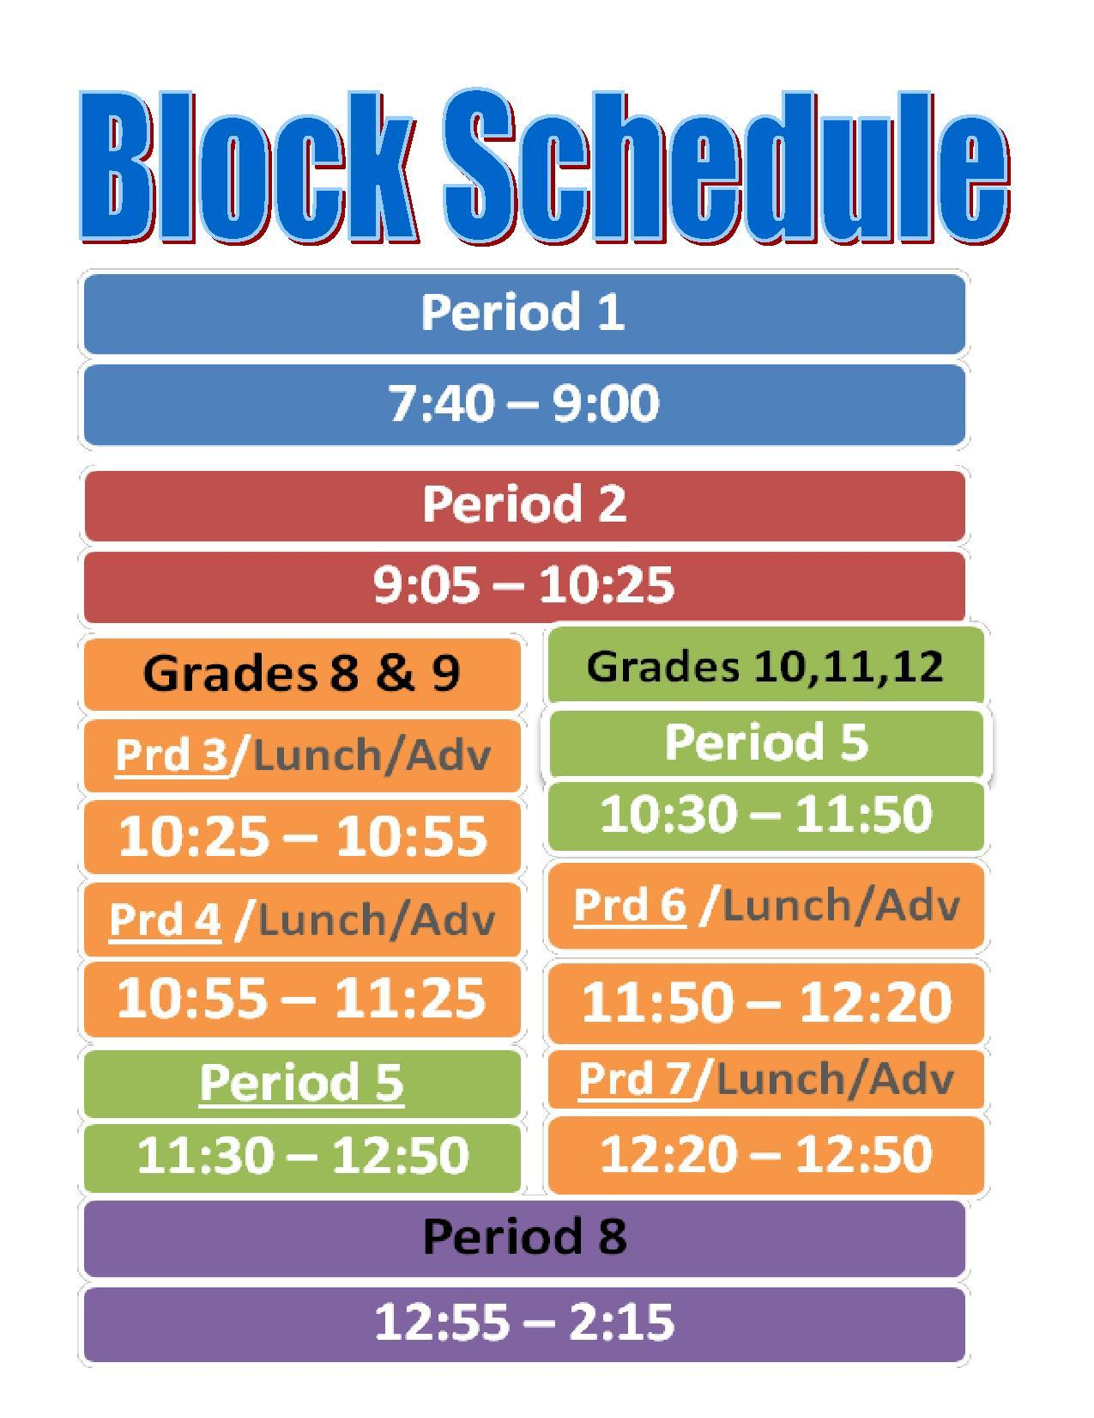
Problem with WIN Time
3-5 sessions weekly are recommended by IES
More minutes per day and more weeks of intervention may be needed for students with lowest screening scores
Students need more than one kind of support

Slide 33
Alternative for Intervention Time
Embed tiered intervention time into literacy and mathematics blocks
Enrichment → Tier 2 → Tier 3
Push in intervention coaches, paraprofessionals, and special education teachers
Schedule Within Grades

Slide 34
Structure of RTI
Tier 1
Empirically supported grade level curriculum
30 minutes of enrichment
Tier 2
Empirically supported grade level curriculum
30 minutes targeted small group intervention based on skill needs
Tier 3
Empirically supported grade level curriculum
30 minutes targeted individual intervention based on skill needs (administered by trained specialist)
Monitor progress weekly
60 minutes core curriculum
Monitor progress every other week
Monitor progress 3 times yearly
60 minutes core curriculum
60 minutes core curriculum

Slide 35
Treatment Intensity
Strength
Delivery Mechanism
Opportunities to Practice

Slide 36
Opportunities to Practice - Math
Grade & Skill Level
Repetitions
4, 5, 6, 7 Multiplication Facts
2, 3 Multiplication Facts
 | Grade 3 | Grade 4
Below Average | 11.24 | 6.21
Average | 8.45 | 4.12
Above Average | 6.37 | 2.82
(Burns, Ysseldyke, Nelson, & Kanive, 2015, p. 401)
Notes:
OTR is defined as each interaction where a student responds to the presented instructional stimulus and immediately receives feedback from the teacher
More the better but
Data for facts 4s and 5s multiplication only

Slide 37
Opportunities to Practice - Math
Codding, Volpe, Martin, & Krebs, in press)
Class-wide Intervention with CCC on Subtraction Facts
Distributed vs Massed Practice (within session) did not matter
Initial fluency level mattered
OTPs mattered (3 vs 6 repetitions of set of 10 problems)

Slide 38
Opportunities to Practice - Reading
(Vaughn et al., 2010)
More Opportunities for Active Engagement
Extended Opportunities to Practice Skills IN ISOLATION
High Levels of Teacher Support & Feedback

Slide 39
Opportunities for Practice
Guided Practice
Drill
Cumulative Review
Practice
Teacher-Led
Demonstration & Modeling
Think Aloud While Solving
Skill in Isolation
Flash Cards
Incremental Rehearsal
Combine New with Previous Learning
Tasks & Activities that Integrate Skills
Integrate Previously Learned Skills & Concepts
Games, Advanced Problems
Notes:
Acquisition
Modeling & Demonstration
Think Aloud
Guided Practice
Practice Partially Worked Problems
Immediate Error Correction
Smaller Slices of Concept or Skill
Make More Concrete
Fluency
More Opportunities for Independent Practice
Feedback on Speed + Accuracy
Self-Monitoring & Graphing
Peer Practice
Generalization
Combine previous and recently learned skills and concepts
Cumulative Review
Solve problems multiple ways
Team-based Activities
Math Games

Slide 40
What is Treatment Intensity?
Strength
Group Size
Task
Delivery Mechanism
Paper or Computer
Notes:
In a survey of reading RTI mallard and colleagues (2010) found that group size is not altered in schools as 1:1 services are not provided and the most common group size was…we already know from what was presented earlier that small groups are better than very large but the size of the small group doesn’t really matter

Slide 41
Computers
Cheung & Slavin (2013) ES = 0.18 (math).
Li and Ma (2010) Greater effect when combined with constructivist approach to teaching (math).
Pellegrini et al. (2018) ES = 0.07 (math).
Slavin et al. (2010) ES = .09 (upper elementary reading) or .06 (beginning reading).
Touch Devices: Moderate Effect Sizes
CAI: Small Effect Sizes
Peterson-Brown et al. (in press) Moderate effect sizes across academic subjects.
Limited quality studies available.
Notes:
CAI which students are assessed, placed at their appropriate level, and then given exercises and ongoing assessments in a step-by-step sequence to move them forward as rapidly as possible (Cheung & Slavin, 2013). Examples include SuccessMaker and Accelerated Math. (other form was visual media). Depends on the program!

Slide 42
Alter the Task
Concrete
Representation
Abstract
Worksheet
Application
Notes:
Matching response topography to the instructional level; dose form, or the physical form in which the active ingredient is dispensed, may be adjusted in terms of the group size, or implementer to student ratio.
– in isolation; in worksheet or generalization -

Slide 43
Type of Task
Word Level Text
Connected Text
Phonemic Awareness
Phonics
Reading Fluency
Notes:
Vaughn et al 2010 found that it didn’t matter as much the proportion of time spent on these activities with struggling readers what mattered more is that they had explicit instruction in phonemic awareness and phonics, high levels of engagement more OTPs and daily text reading with feedback

Slide 44
Explicit & Systematic Instruction
Students with math difficulties, disabilities, and English Language Learners BENEFIT MORE from explicit instruction than discovery-oriented methods
(Kroesbergen & Van Luit, 2003)
Large
Notes:
A meta-analysis of 58 math studies (Kroesbergen & Van Luit, 2003) revealed that students with math disability or difficulty benefit more from explicit instruction than discovery-oriented methods. Effective intervention requires an explicit, didactic form of instruction in which the teacher directly shares the information the child needs to learn.

Slide 45
Explicit & Systematic Instruction
EXPLICIT
SYSTEMATIC
Preview Skills or Concepts Connect New to Previous Learning
Provide Precise Instructions
Model Concepts or Procedures
Provide OTPs
Provide Immediate Feedback
Checks for Maintenance
Lessons are Hierarchical
Breaks Skills or Concepts into Smaller Chunks (task analysis)
Order Tasks from Easy to Difficulty
Scaffold Instruction with Temporary Supports
STATED CLEARLY AND IN DETAIL, LEAVING NO ROOM FOR CONFUSION OR DOUBT.
~Oxford Dictionary
Notes:
Immediate feedback – error correction, reteaching, clarify instructions
(teacher verbalizes his or her thought process while demonstrating)

Slide 46
What is Treatment Intensity?
Complexity
Number & Type of Treatment Components
Set Size
(Barnett, Daly, Jones, & Lentz, 2004; Codding & Lane, 2015; DeFouw, Codding, & Collier-Meek, in press
Mellard, McKnight, & Jordan, 2010)
Notes:
treatment complexity includes the number and type of treatment components, goal specificity, set size, (Barnett et al., 2004; Mellard et al., 2010)

Slide 47
Set Size: Math
( Burns et al., 2016; Poncy et al., 2015 )
As SET SIZE increases, magnitude of intervention effect decreases
Example: Set Size
  2 Facts→ ~50% Retention
  4 Facts → ~75% Retention
  8 Facts → ~33% Retention
Set Size
Number of Items Targeted
Notes:
treatment complexity includes the number and type of treatment components, goal specificity, set size, (Barnett et al., 2004; Mellard et al., 2010) or Scope of the Curriculum
Are you targeting the entire set of multiplication facts or does the student only miss the 6s and 7s?
Poncy – synthesis of research
Burns et al – 55 3-4th graders multiplication facts

Slide 48
Set Size: Word Reading
2 Words
Too Few
4-6 Words
Just Right
8 Words
Too Many
Haegele & Burns (2015): Too few or too many unknown words →poorer reading outcomes as compared to a condition that generated individual rates of learning.
Breaking down broader learning objectives into:
  smaller sub-components that are mastered first…
  …might be necessary for students with larger learning gaps or those who are not responding to interventions as anticipated
Notes:
Haegele and Burns (2015) illustrated that providing too few or too many unknown words produced poorer reading outcomes as compared to a condition that generated individual rates of learning. Breaking down broader learning objectives into smaller sub-components that are mastered first might be a necessary step for students who experience larger learning gaps or are not responding to interventions as anticipated

Slide 49
Consider Sequence of Content
n+1/1+n
Doubles (2-10)
n+2-9/2-9+n
n+0/0+n
Missing number
3 + n = 7
Making 10s
EASY
HARD
Notes:
Are you targeting the entire set of addition facts or does the student only miss the sums over 10? If the error pattern is sporadic then you can order the missing problems according to easiest to hardest and practice a small set to mastery first before moving on to the next harder set.
In reading identify the words or CVC sequence that is needed or the phoneme isolation or phoneme blending

Slide 50
Phonemic Awareness
Phoneme deletion and manipulation
Blending and segmenting individual phonemes
Onset-rime blending and segmenting
Syllable segmenting and blending
Rhyming
Word Comparison
MOST
Complex
LEAST
Complex

Slide 51
Dialing up the Salience of Feedback
Adding Intervention Components
None
Verbal
Self-recording
Self-charting
+ Goal line
+ Reward
(Codding, Volpe, & Poncy, 2017)
Notes:
Figure 6.3. Dialing up the Salience of Performance Feedback = increase students’ effort and attention

Slide 52
Adding Salience = Meaning
I’m running on the treadmill-
I ran on the treadmill
I am going to run on the treadmill
I’m at my extra math class
I went to my extra math class
I am going to my extra math class
BORING

Slide 53
Adding Salience = Meaning
Build slow, stay loose, press on, my split looks good…
I met my goal.
I thought I could.
I had some left over…
I am going to run 4 miles at a 8 min./mi pace
I circled my goal, I am going to focus on what I know…
I met my goal.
I thought I could.
I even knew more…
I am going to solve 5 more problems in math class.

Slide 54
Adding Performance Feedback
Self-Scoring
Self-Charting
Praise
Choice
Notes:
Correct own work - self charting
Inaccurate (praise in the absence of accomplishment)
Focused on abilities (e.g., intelligence, physical attractiveness, artistic ability)
not in their control
Linked to accomplishments
Focused on things in the student’s control
Effort
Use of effective strategies
No praise at all
Ask the student instead “How do you feel about what you just did?”
“What did you enjoy most about that?”

Slide 55
Goals…
Specify the requirements for success
Prompt monitoring and self-evaluation
Setting and achieving goals helps maintain high levels of motivation

Slide 56
Goal Attainment & Goal Setting
Completion time & accuracy (Skinner et al., 1993)
Completing worksheet in x amount of time with 100% accuracy
Goal to reach criterion on 3 of 4 consecutive assessments
Digits correct/incorrect (Codding et al. 2009)
Digits correct in x amount of time
E.g., Increase DC by one unit over previous assessment
Accuracy of procedural steps (Fuchs et al., 2003)
Number of procedural steps followed correctly.
Beat previous score or repeat 100% from last session.
Teacher Selects Goal
Student Selects Goal
Goal Set Each Session
Only Final Goal
Daily & Final Goals

Slide 57
Benchmark Criterion
Today’s
Goal is 34
Problems
Correct
(Codding, Chan-Iannetta, Palmer, & Lukito, 2009)
Notes:
Figure 6.2. Sample Goal Setting Chart with Performance Feedback

Slide 58

(Codding, Volpe, & Poncy, 2017)
Student: ______________
Dates:
_____
_____
_____
_____
_____
Notes:
For Appendix 6.1: Student Self-charting Form

Slide 59
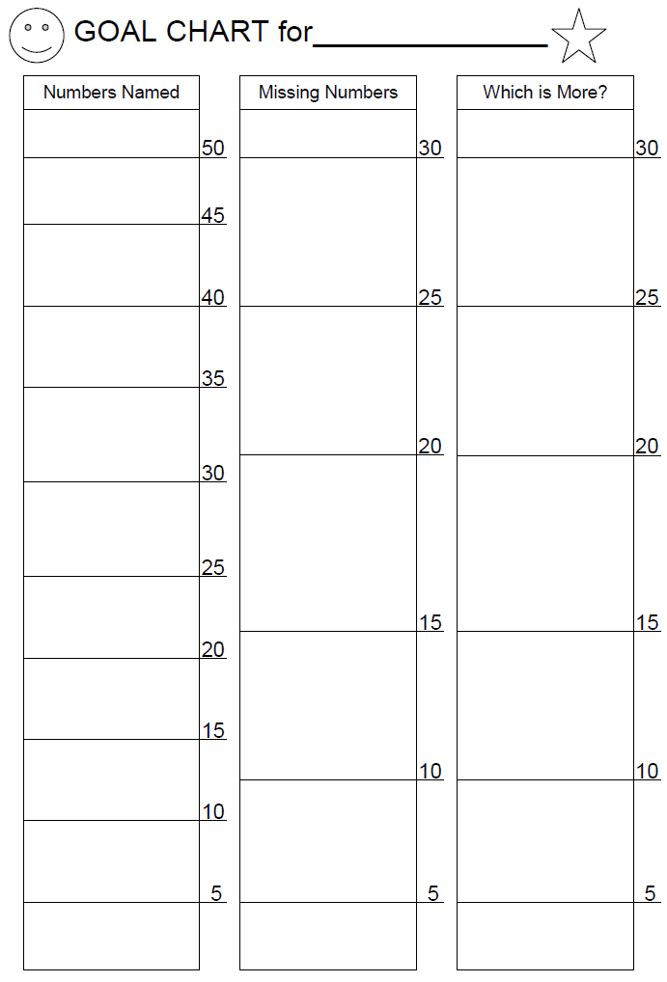
(Codding, Chan-Iannetta, George, Ferreira,. & Volpe, 2011)

Slide 60
Reinforcement
WHAT
WHY
HOW
Tangible
Edible
Activity or Privilege
Contingent on:
  PERFORMANCE
  EFFORT
  ENGAGEMENT
  PERSISTENCE
Token Economy
Group Contingency
Behavior Contract
Mystery Motivator
Pre-Determined Prize
Notes:
We know that a challenge particular to math is that you have to “stick with it” to see a problem through and we already discussed that all kids need to practice numerous times so providing rewards for persistence and effort might be really necessary especially for children struggling in math

Slide 61

Token Economy
(Codding, Volpe, & Poncy, 2017)
Five Frames for Reinforcement
5 stickers = trade in for______________

Slide 62
Variation of the Good Behavior Game
(e.g., Flower, McKenna, Bunuan, Muething, & Vega, 2014)
Talk Only About Math
Listen to Your Friends
Try Hard
Teacher | Group

Slide 63
Summary
Increase Strength
Adjust Session Length, Frequency, or Total Duration
Alter the Task
Increase OTPs
Decrease Group Size
Increase Complexity
Add Salient Feedback
Add Goal Attainment or Setting
Add Reinforcement
Decrease Set Size

Slide 64
Translating Intensity into Data-Based Decisions
Application

Slide 65
Reasons For Students’ Academic Difficulties
Tier 2 Services
Don’t Want To
Not Enough Practice
Need More Help
Its Too Hard
Increase Support
More
OTPs
Motivation
Deficit
Evaluate Knowledge of Pre-Requisite Skills
(Daly et al., 1997)

Slide 66
Guidelines for Support Services
Tier 2
Strategic Group Delivered Interventions
Some Risk
Tier 3
Smaller Group or Individualized
Interventions
High Risk
Between the 11th and 25th Percentile
At or Below the 10th Percentile
Borderline
Progress is Monitored BUT Intervention is NOT Delivered
Borderline Risk
Between 25th & 35th Percentile

Slide 67
First Thing First
Was the student present for 85% -95% of sessions
Yes
Evaluate treatment integrity data
Intervention implemented for about 80% of sessions?
No
Is the student absent from school?
Is the student avoiding treatment
Address Absenteeism
Determine reasons for avoidance
Yes: Evaluate Response to Treatment
No: Evaluate why treatment integrity was low & make a plan to improve integrity

Slide 68
Intensifying Supports
INCREASE DOSE: Session Length, Frequency, Total Duration
CHANGE ASSISTANCE: Match Instruction to Skill Hierarchy (consider how information is delivered-task)
ADAPT INTERVENTION: Add or Alter or Change Components
CHANGE GROUPING: Homogenous Groups; Smaller Teacher: Student Ratio
ADJUST TARGET SKILL: Slice back (pre-rec skills), break down task into small set, or set new goals
(Codding et al., 2017; Daly et al., 1997; Haring et al, 1978)

Slide 69
Fine Tuning Supports with Assessment
(Codding et al., 2017; Daly et al., 1997; Haring et al, 1978; Lembke et al., 2012)
Conduct a Brief Experimental Analysis
Administer a Survey-Level Assessment
Conduct an Error Analysis
Determines Known and Unknown Skills
Determine Error Patterns → Find Misconceptions
Tests Different Intervention Strategies

Slide 70
Brief Experimental Analysis (BEA-Math)
(Codding et al., 2009; 2017; Daly et al., 1997; Kleinert et al., 2018)
Digits Correct Per Minute
Sessions
Notes:
Figure 11. 6 Abridged Brief Experimental Analysis

Slide 71
BEA Reading
(Jones & Wickstrom, 2001, p. 561)
85% Accuracy & 32 WRCM Differentiated Students Benefiting from Acquisition or Fluency Intervention
(Szadokierski, Burns, & McComas, 2017)
Bl = Baseline In = Incentive
RR = Repeated Reading PD = Phrase Drill
EM = Easier Material

Slide 72
Survey Level Assessment
(Burns, VanDerHeyden, & Jiban, 2006; Burns, Codding, Boice, & Lukito, 2010; Gravois & Gickling, 2008)
Purpose
Identify Specific Skill Strengths & Weaknesses
Grade Level
Administer CBM-GOM in lower grade levels to find instructional level
Target Skills
Determine pre-requisite skill hierarchy
Use single-skill CBA or CAT & determine instructional level

Slide 73
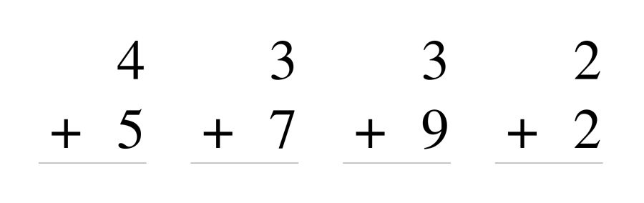
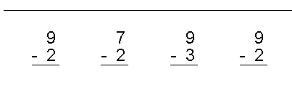
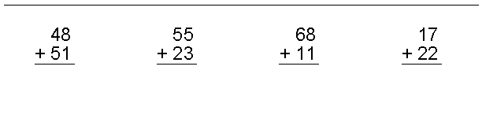
Notes:
3rd grade GOM

Slide 75
Error Analysis
(Allsopp et al., 2008; Codding et al., 2017; Dennis et al., 2014)
Identify Target Skill
Create Error Analysis Chart
Administer CBM or CAT or Unit Test
Score Test for Error Types
Record Results on Error Analysis Chart
Notes:
Math Fact (single digit computation errors)
Procedural (misapplication or lack of knowledge of procedural steps)
Visual-Spatial/Visual Monitoring (misreading numbers, column alignment, or inadequate spacing of written work)
Switch (difficulty switching between two or more operations)

Slide 76
Error Analysis: Math
(Allsopp et al., 2008; Codding et al., 2017; Dennis et al., 2014)
Complex Computation
Basic Fact Error
Omitted Procedural Steps
Visual-Spatial
Switching Operations
Place Value
Notes:
Math Fact (single digit computation errors)
Procedural (misapplication or lack of knowledge of procedural steps)
Visual-Spatial/Visual Monitoring (misreading numbers, column alignment, or inadequate spacing of written work)
Switch (difficulty switching between two or more operations)

Slide 77
Error Analysis: Reading
Grapho-phonetic
Preserves an aspect of phonetics of the written word
Syntactic
Preserves grammar of the written word
Semantic
Preserves meaning of sentence
FRIEND is spoken as FRIED
RAN is the same part of speech as JOGGED
THE WOMAN IS TALL has the same meaning as THE LADY IS TALL
Notes:
Also can identify if students transpose words, attend only to initial sounds, guess – SEE NCII

Slide 78
BEA Again: No Response To Intervention
(Fuchs, Powell et al. 2010)
Immature Counting Strategies
No Automatic Retrieval
Teach Efficient Counting Strategies (e.g., min → decomposition →computer drill & practice)
Flash Card Drill & Goal Attainment → Mix Computer & Flash Card Practice
Determine Strategies Used to Derive Answers
Or Error Patterns
Use BEA Tool to Investigate Best Approach

Slide 79
Intensifying Supports
INCREASE DOSE: Session Length, Frequency, Total Duration
CHANGE ASSISTANCE: Match Instruction to Skill Hierarchy (consider how information is delivered-task)
ADAPT INTERVENTION: Add or Alter or Change Components
CHANGE GROUPING: Homogenous Groups; Smaller Teacher: Student Ratio
ADJUST TARGET SKILL: Slice back (pre-rec skills), break down task into small set, or set new goals
(Codding et al., 2017; Daly et al., 1997; Haring et al, 1978)

Slide 80
Case Practice 1
What Does this Graph Show About Performance Level?
What Does this Graph Show About Growth Over Time?
Notes:
What should you DO?
Strength options: increase dose (frequency, total duration, length of session), change assistance (consider how the information is delivered, instructional match, acquisition and fluency), change grouping – integrate student with new group with homogenous skills, reduce group size
Complexity options: alter intervention components, adjust target skill – slice back, reduce set size, consider sequence of materials
In this case: Because the student is making progress, albeit below the goal line, consider increasing the frequency of these sessions per week and possibly adding goal setting (daily and target goals), choice, or reinforcement

Slide 81
Case Practice 2
What Does this Graph Show About Performance Level?
What Does this Graph Show About Growth Over Time?
Notes:
What should you DO?
Strength options: increase dose (frequency, total duration, length of session), change assistance (consider how the information is delivered, instructional match, acquisition and fluency), change grouping – integrate student with new group with homogenous skills, reduce group size
Complexity options: alter intervention components, adjust target skill – slice back, reduce set size, consider sequence of materials
In this case: This student is not making meaningful progress. Assuming there are no issues with absenteeism or integrity adjusting the target skill (are pre-requisite skills mastered? Is too much material presented at once? Should the task be altered such that concrete representations are used)? Other considerations include: (a) increase time in session and increase frequency per week, (b) reducing group size assuming this student has more intense needs or change groups to ensure that his needs are similar to his group.

Slide 82
Data-Based Decision Making
Little/No Improvement
Teach Pre-Requisite Skill
Change Grouping
Adapt
Intervention
Adjust
Target Skill
Fade Dose
Remove & Monitor
Slow Improvement
Increase Dose
Change Assistance
Adapt
Intervention
Change Assistance
Meets Goal
Make No Changes
Reduce Assistance
Exceeds Goal

Slide 83
Intervention Resources
What Works Clearinghouse
http://ies.ed.gov/ncee/wwc/findwhatworks.aspx
Best Evidence Encyclopedia: Center For Data Driven Reform
RTI Action Network
John Hopkins University; http://www.bestevidence.org
www.rtinetwork.org
Center on Response to Intervention
http://www.rti4success.org/
IRIS Center
https://iris.peabody.vanderbilt.edu/module/math/challenge/#content
National Center on Intensive Intervention
https://intensiveintervention.org/

Slide 84
Resource

Slide 85
Inside the Taxonomy of Intensity…

Slide 86
Resources
U.S. Department of Education; Institute for Education Sciences: National Center for Educational Evaluation & Regional Assistance

Slide 87


Questions and/or Comments
Robin S. Codding, Ph.D., BCBA-D
rcodding@umn.edu

