Slide 1
PRACTICAL LEGAL ISSUES A review of the nuts and bolts of every day school law issues
By Jill Coyle
January 26, 2018

Slide 2
Today’s Topics
Responding to Parental Disagreement
Subpoenas 101
Abuse and Neglect Reports
Student Discipline
Data Privacy 101
Discrimination, Bullying & Harassment
Common Special Education Disputes

Slide 3
When Parents Disagree

Slide 4
Physical Custody
Visitation
Legal Custody
Parental Rights

Slide 5
Presumption of Parental Right to Access
(Minn. R. 1205.0500, subp. 2) (paraphrased)
The school shall presume a parent has the authority to access data on the child unless the school has been provided with evidence that there is a state law or court order governing such matters as divorce, separation or custody or a legally binding instrument which provides to the contrary.

Slide 6
Minn. Stat. 120A.22 COMPULSORY INSTRUCTION
Subd. 1a. Noncustodial parent access to records.
Upon request, a noncustodial parent has the right of access to, and to receive copies of, school records and information, to attend conferences, and to be informed about the child's welfare, educational progress, and status, as authorized under section 518.17, subdivision 3. The school is not required to hold a separate conference for each parent.

Slide 7
Minn. Stat. 13.32 EDUCATIONAL DATA.
Subd. 10a. Access to student records; school conferences.
(a) A parent or guardian of a student may designate an individual… to participate in a school conference involving the child of the parent or guardian. The parent or guardian must provide the school with prior written consent allowing the significant individual to participate in the conference and to receive any data on the child of the consenting parent or guardian that are necessary and relevant to the conference discussions. The consenting parent or guardian may withdraw consent, in writing, at any time.

Slide 8
Let’s Talk About…
When one parent consents to a special education evaluation and the other refuses.
When parents disagree over:
school of enrollment
who can pick up the child
the rights of a step-parent
Requests for letters or affidavits for use in a custody proceeding
Orders for Protection & Harassment Restraining Orders

Slide 9
SUBPOENAS 101

Slide 10
Testimony Records
Witness Fees
Time Off Work

Slide 11
Sample Subpoena Letter
The purpose of this letter is to inform you in writing that Independent School District No. has received a subpoena for your child’s school records and/or to testify about your child. The records and/or testimony were subpoenaed in a matter captioned [fill in caption on subpoena]. The records and/or testimony were subpoenaed by
Federal law (34 CFR 99.31(a)(9)) requires the School District to notify you of the subpoena in advance of compliance in order to provide you time to seek a protective order if you so desire. The School District plans to produce the subpoenaed records and/or testify on , unless you have obtained a protective order by this time.
Thank you for your attention to this matter.

Slide 12
ABUSE & NEGLECT REPORTS

Slide 13
Mandated Reports
Mandated Reporting
Know or reasonably suspect a child has been maltreated in past 3 years
Maltreatment=physical abuse, sexual abuse, threatened abuse, neglected
If you believe a child has been maltreated, report it immediately to your supervisor and the proper authorities
If you suspect a school district employee has maltreated a child, report it to Minnesota Department of Education. (651-582-8546)
If you suspect a parent (or someone else with authority over child) has maltreated a child, report it to County Child Protection Services.
In emergencies, call 911 and report to police
Timelines: 24 hours for a verbal (phone) report; 72 hours for follow-up written report
Immunity for good faith reports
Identity of reporter is kept confidential

Slide 14
Let’s Talk About . . .
When a staff member is the alleged perpetrator.
When a sibling is the alleged perpetrator.
When another student is the alleged perpetrator.

Slide 15
STUDENT DISCIPLINE

Slide 16
Disciplinary Trends
Limits on expulsion (case law)
Restorative measures and trauma informed schools
Disproportionality concerns

Slide 17
Discipline of Special Education Students …we better have a flow chart.

Slide 18
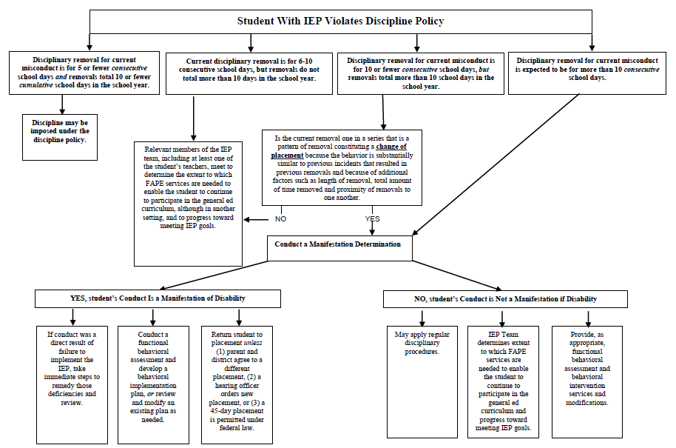

Slide 19
45-Day Placements
Available for certain weapons or drug offenses or when a student inflicts serious bodily injury on another at school.
School days, not calendar days.
Can be imposed even if conduct is a manifestation.
Nature of placement is determined by IEP team.
Subject to parental challenge, but the 45-day placement is the stay put.

Slide 20
Protections for students “not yet eligible.”
IDEA protections are available if the school has knowledge that the student was a child with a disability before the conduct occurred. There is a basis of knowledge if:
Parent expressed concern in writing that the student needed special education.
Parent requested an evaluation
Staff expressed concern about a pattern of behavior to director of special education or other supervisor.

Slide 21
Protections for students “not yet eligible.”
IDEA protections are not available if:
Parent did not allow for a special education evaluation.
Parent refused special education services.
Child was evaluated for special education services and did not qualify.

Slide 22
The “last minute referral.”
If a request is made for a special education evaluation after conduct occurs, the evaluation must be done in an expedited manner
Child remains in placement determined by school, which can include suspension or expulsion.
If child is found eligible, special education services must be provided.

Slide 23
10-Day Rule for Mental Health Referrals
Minn. Stat. 121A.45 GROUNDS FOR DISMISSAL
Subd. 3.Parent notification and meeting.
If a pupil's total days of removal from school exceeds ten cumulative days in a school year, the school district shall make reasonable attempts to convene a meeting with the pupil and the pupil's parent or guardian before subsequently removing the pupil from school and, with the permission of the parent or guardian, arrange for a mental health screening for the pupil. The district is not required to pay for the mental health screening. The purpose of this meeting is to attempt to determine the pupil's need for assessment or other services or whether the parent or guardian should have the pupil assessed or diagnosed to determine whether the pupil needs treatment for a mental health disorder.

Slide 24
Data Privacy 101

Slide 25
The handling of student records is governed by state and federal law.
Minnesota Statute 13.32 (Minnesota Government Data Practices Act)
20 USC 1232g (Federal Educational Rights and Privacy Act “F.E.R.P.A.”)

Slide 26
Three Classifications in MN Law
Public
Private
Confidential

Slide 27
A limited amount of student information is classified as public directory information. Directory information typically includes:
Name
Address, telephone and email (but not in all school districts)
Date and place of birth
Major field of study
Participation in activities and sports
Weight and height of athletes
Dates of attendance
Enrollment status
Degrees, honors and awards received
The most recent educational institution attended
Photograph
Grade level

Slide 28
Most student information collected or maintained by schools is classified as “private.”
Private information may not be released to members of the public without consent or as otherwise specifically permitted by law.

Slide 29
Private data may only be shared within the School District on a need-to-know basis.
Avoid teachers’ lounge gossip
Consider keeping student identity private when discussing a situation with colleagues.
“Need-to-know” extends to volunteers and contractors.

Slide 30
Private data may not be shared outside the District without consent or as otherwise permitted by law.
Exercise extreme caution with disciplinary information.
Exercise extreme caution with disability information.
Exercise extreme caution with your community conversations.

Slide 31
Parents have a right to access all of their own child’s private data.
Use caution when e-mailing colleagues.
Don’t put something in writing that you will later regret.
Watch out for “commingled” data.
Noncustodial parents do not generally lose the right to access student data.
The “Desk Drawer Exception” is a very limited exception.
Data can’t be shared with anyone other than a substitute teacher.
Data must be destroyed at the end of the year.

Slide 32
A very limited amount of data may be classified as “confidential.”
Confidential data is not accessible by the data subject.

Slide 33
Keezer Data
Unrecorded mental impressions don’t count as data.
Exercise extreme caution before assuming information is only an “unrecorded mental impression.”

Slide 34
Civil Remedies and Penalties
Lawsuit for damages or compliance (M.S. 13.08)
Attorney’s fees
Civil penalty
Injunction (M.S. 13.08)
A willful violation is a misdemeanor (M.S. 13.09)
Cause for suspension or dismissal (M.S. 13.09)

Slide 35
SPECIAL EDUCATION LEGAL DISPUTES

Slide 36
I.E.E.s (Independent Educational Evaluations)
Parents can obtain an I.E.E. at their own expense.
Parents have a right to an I.E.E. at public expense if they disagree with an evaluation by the district.
To refuse an I.E.E., the district must ask for a due process hearing and prove that its own evaluation was appropriate.
Districts cannot simply ignore a parent’s I.E.E. request.
District’s must provide information about their criteria for I.E.E.s.

Slide 37
Implementation Errors
Don’t overpromise
Collect data
Share the IEP with all whom have the responsibility to implement adaptations
Remedy errors if possible

Slide 38
Resistance to Restrictive Settings
Hold meetings
Arrange tours
Document the IEP team’s proposal
Collect data
Try mediation
Consider a hearing???

Slide 39
Formal Dispute Processes
MDE Complaints
Special Education
Maltreatment
Board of Teaching
OCR Complaints
MDHR Charges
Data Privacy Complaints
Due Process Hearings
Lawsuits

Slide 40
Gather all records
Involve counsel and insurer
Don’t be obstructionist or defensive
Tell your story clearly
Remedy errors if they exist

Slide 41
DISCRIMINATION, BULLYING & HARASSMENT

Slide 42
Bullying
Bullying means: Intimidating, threatening, abusive, or harming conduct that is objectively offensive and:
There is an actual or perceived imbalance of power between the student engaging in the conduct and the target of the conduct and the conduct is repeated or forms a pattern, or
Materially and substantially interferes with a student’s educational opportunities or performance or ability to participate in school functions or activities or receive school benefits, services or privileges
Cyberbullying is prohibited
For a school’s bullying policy to apply, there typically must be a nexus between the conduct and the school environment
Each school district is required to have a bullying policy, a process for investigating complaints and to offer staff training.

Slide 43
Bullying
Resources on bullying in schools can be found on the MDE’s School Safety Technical Assistance Center webpage:
http://education.state.mn.us/MDE/dse/safe/

Slide 44
Discrimination & Harassment
State and federal law, as well as school district policies, prohibit students or staff from harassing or discriminating against others on the basis of protected class.
Protected class=sex, race, religion, color, creed, national origin, marital status, familial status, disability, status with regard to public assistance, sexual orientation, membership or activity in a local human rights commission age or genetic information
Harassment can be physical and/or verbal

Slide 45
Let’s Talk About . . .
Rights of transgender and gender diverse students
Title IX complaints
When the complainant asks you not to do anything or to guarantee confidentiality
Responding to false accusations

Slide 46
Thank You!

