Slide 1
Safe Harbor in a Storm: MN Response for Youth Who Are Sexually Exploited
Paula Schaefer| MDH Heidi Kopischke| The Link
Brandy Maddox| The Link Trevor Berberick| Midwest Children’s Resource Center

Slide 2
Forms of Sexual Exploitation
SEXUAL
EXPLOITATION
Sexual Harassment
Sexual Abuse/ Assault
COMMERCIAL
SEXUAL EXPLOITATION
Survival Sex
Pornography
$
Prostitution
Stripping
Sex Trafficking
Do Justice LLC 2014
Notes:
SLIDE 15
Proposed Script: Many people acknowledge a broader working understanding of sex trafficking. As this graphic shows, sex trafficking is just one form of commercial sexual exploitation which, in turn, fits within even broader category of sexual exploitation. In addition, sexual exploitation overlaps with other forms of violence against women such as domestic violence. While these broader forms of sexual exploitation that may not fall under the legal definition of sex trafficking they are still extremely damaging to individuals as well as our society and support a culture in which sex trafficking thrives.
It is important to understand sex trafficking within this larger context of sexual exploitation because, being a victim of one form of sexual exploitation makes a person more vulnerable to becoming a victim of commercial sexual exploitation, and in turn, more vulnerable to becoming a victim of sex trafficking. So if we really want to stop or prevent sex trafficking, we have to address all forms of sexual exploitation.
This is especially important for people who work in related areas to know. As they start uncovering trafficking cases, they will also see these other forms of violence and exploitation. They may also see ties with labor trafficking. As groups prepare their response to sex trafficking in various disciplines or regions, they should also evaluate their response to other related forms of violence and exploitation.

Slide 3
Commercial Sexual Exploitation Eligibility for Safe Harbor Services for Youth Ages 24 and younger
Anything of value (e.g., money, drugs, food, shelter, rent, or higher status in a gang or group)
- OR -
a promise of anything of value
is given to a person by any means in exchange for any type of sexual activity.
A third party may or may not be involved.
Youth at-risk for sexual exploitation are eligible for Safe Harbor Regional Navigator and Specialized Community Services.
http://www.health.state.mn.us/injury/topic/safeharbor/
Copyright 2016 SVJI @ MNCASA

Slide 4
Signs and Indicators
Does the student have unexplained absences from school, or has the student demonstrated an inability to attend school on a regular basis?
Has the student suddenly changed his or her usual attire, behavior, or relationships?
Does the student suddenly have expensive material possessions?
Does the student chronically run away from home?
Does the student defer to another person to speak for him or her, especially during interactions with school authority figures (this may include an adult described by the student as a relative, but may also be a friend or boyfriend/girlfriend)?
Does the student talk about frequent travel?

Slide 5
Signs and Indicators
Does the student have a history of attending many different schools or has multiple recent transfers?
Does the student have a “boyfriend” or “girlfriend” who is noticeably older?
Is the student making references to sexual situations or terminology that are beyond age-specific norms?
Can the student freely contact friends, family, or his or her legal guardian, or does someone else control this communication?
Does the student use sex industry lingo: refers to controller as boyfriend, pimp, manager, or “daddy”; refers to commercial sex as “The Life,” or “The Game”; refers to dates as “Johns” or “Tricks.”
Does the student have numerous inconsistences in their story when recounting life outside of school?

Slide 6
Minnesota’s Response to Sex Trafficking - No Wrong Door
Notes:
Paula
SLIDE 40
Proposed Script: So what is Minnesota’s Response to sexual exploitation? Minnesota has shown itself to be a leader in its response to sexual exploitation. From the way we define sexual exploitation to our recently passed Minnesota Safe Harbor Law which changes the way we identify and respond to juvenile victims of exploitation.
Internal Notes: For slides 40-53, direct participants to the relevant handouts on Safe Harbors based on your audience.

Slide 7
Safe Harbor Law
Sexually exploited youth
17 years old and under
can no longer be criminalized for engaging in prostitution, instead should be referred to services.
Sexually exploited youth
24 years old and under
deserve and are eligible for specialized, trauma-informed
services to heal and recover.
Notes:
SLIDE 42
Proposed Script: Minnesota’s Safe Harbor Law is a statewide effort to provide shelter and services for Minnesota’s sexually exploited youth. The law recognizes juveniles who are commercial sexually exploited as victims and not criminals. It directs them to services and away from criminal sanctions. Minnesota’s Safe Harbor Law resolves a conflict within the law that identified juvenile victims of commercial sexual exploitation, including trafficking, as both victims and children in need of services AND criminals engaging in prostitution. Victims who fear criminal prosecution or who are prosecuted will not trust the system that is trying to help them. It is harder to find such victims, provide them with services, and engage them in the prosecution of the trafficker and purchasers.
In essence, the MN Safe Harbor Law resolved this conflict and explicitly stated that commercially sexually exploited youth who are under 18 years old can no longer be criminalized for engaging prostitution and, instead, should be referred to services. They can no longer be found guilty of their own sexual exploitation.
While this conflict was resolved for juveniles, it still exists for adult victims of trafficking.
Internal Notes:
Sometimes there is confusion as to what age is covered by the law and if there is a separate response for 16 and 17 year olds. This confusion is caused by the fact that when the MN Safe Harbor Law was first passed, it distinguished between youth 15 and under compared to 16 and 17 year olds. This distinction revealed an underlying belief that older juveniles were somehow more responsible in their own sexual exploitation and was a difficult compromise to get the overall law passed. Thankfully, that mistaken understanding was clarified and the law was amended in 2013 to include all juveniles under 18 as was initially intended by the drafters. As of 2013, there is no age distinction for juveniles under the age of 18. However, as mentioned the distinction still exists for anyone 18 or older.
It should also be noted that not everyone in the criminal justice system treated victims like criminals prior to the Safe Harbor law. Many prosecutors were not prosecuting juvenile victims of trafficking for engaging in prostitution and some law enforcement officers who would find victims would try to find them services and avoid arresting them. Instead, the threat of delinquency charges was sometimes used as a tool to obtain cooperation in valuable cases against the trafficker and the goal of the arrest or victim detention would be to keep the victim away from her pimp. Officers said it was sometimes the only way to keep the victim safe.
Even though it was not the overwhelming practice of many in the criminal justice system to treat these juveniles as criminals, it was still problematic that our State’s laws allowed for that to happen. Also, officers, prosecutors, and service providers alike, all said that there should be a different option and better tools available to help with prosecution of traffickers and protecting victims. So that was what Safe Harbor and the No Wrong Door Model wanted to create.

Slide 8
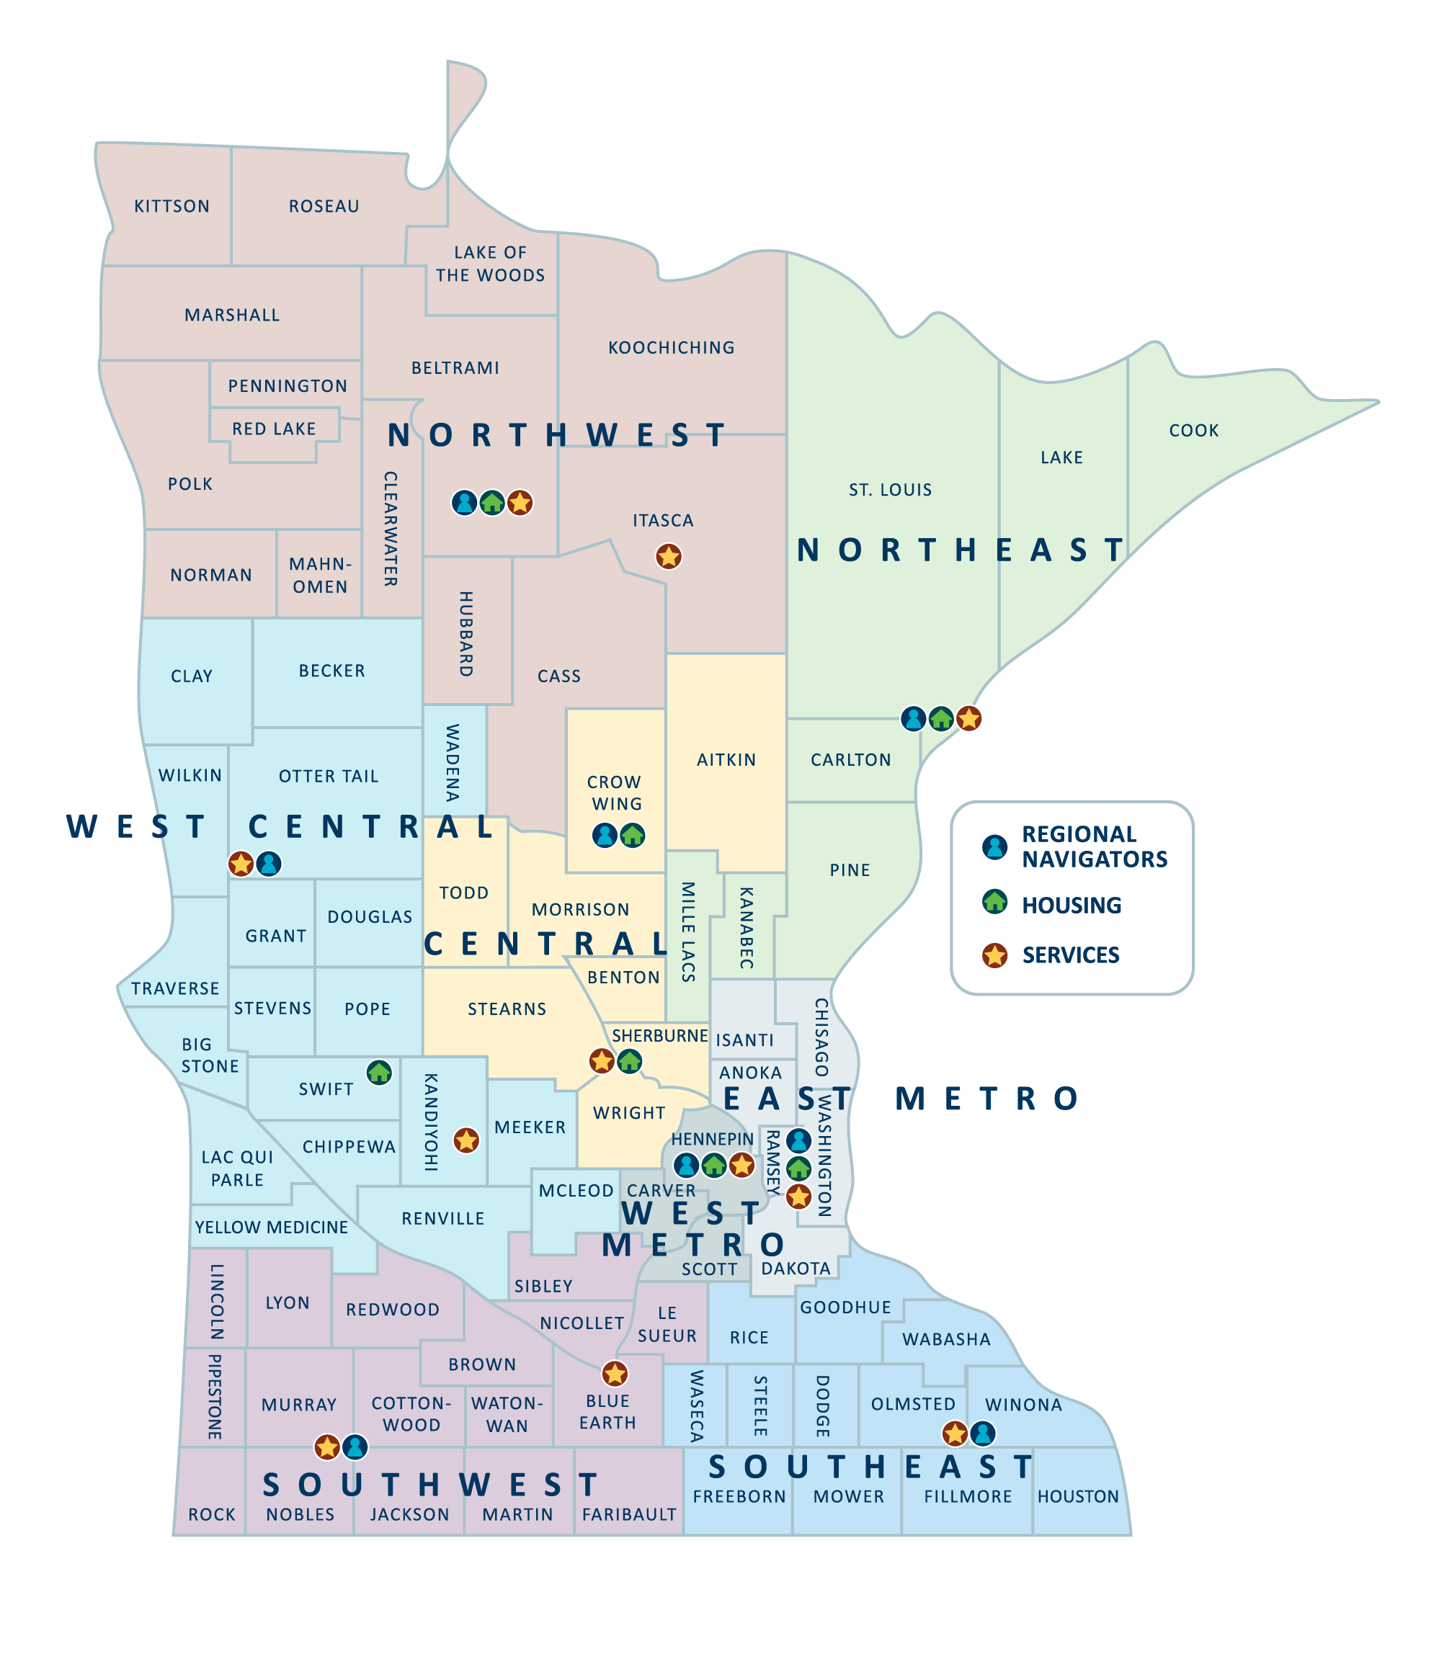
Safe Harbor Statewide Services

Slide 9
Best Practice Working with Sexually Exploited Youth
Survivor informed, survivor involvement
Culturally relevant and responsive
Strength-Based
Harm reduction

Slide 10
Minnesota’s Child Protection Response to Sex Trafficking
Training for Child Protection/Welfare Workers
Child Protection Response
Coordination with Safe Harbor and Systems Response
Data
Reporting
Child Sex Trafficking
Sex Abuse
Child Abuse and Neglect
Investigation (24 hour response)
Sarah.Ladd@state.mn.us www.dhs.gov/safeharbor
Notes:
Effective May 29, 2017, Minnesota’s child welfare system is required to respond to all reports of sex trafficking involving children.
That response is driven by changes to the federal and state child protection laws. These changes to the law are based on research that shows many children who are trafficked for sex in the US have a history of involvement in the child welfare system, and also on public policy that emphasizes sex trafficking as a severe and dangerous form of child abuse.
Specifically, the federal Justice for Victims of Trafficking Act, Public Law (P.L.) 114-22, amendments to Child Abuse Prevention and Treatment Act (CAPTA) required:
Consideration of any child who is identified by an agency as a victim of sex trafficking or severe forms of trafficking as a victim of “child abuse and neglect” and “sexual abuse” regardless of who the offender is.
Investigation of allegations of children known or highly suspected as victims of sex trafficking
Collection and reporting of the number of children who are victims of sex trafficking as part of the National Child Abuse and Neglect Data System (NCANDS)
Training for child protection/welfare workers
Changes to Minnesota Statute were made in the 2015-16 legislative session so that all reports of child sex trafficking must be investigated by child protection as a form of sexual abuse. (Minn. Stat. 626.556 subd 2(n) and 3e) Here in Minnesota, three very important parts that support the changed response to sex trafficking are: (1) training for child protection workers, (2) increased coordination with safe harbor and other systems, and (3) accurate data collection.
In Minnesota, sex trafficking is defined as:
“Receiving, recruiting, harboring, providing, or obtaining by any means an individual to aid in the prostitution of the individual; or receiving profit or anything of value, knowing or having reason to know it is derived from an act described in clause (1).” (Minn. Stat. 609.321, Subd. 7a and 7b)
The actions must be carried out by someone other than the “buyer” of the sex act or the victim.
*Contact Sarah Ladd, DHS Child Protection Program Coordinator for more information or assistance with this new response*
Sarah K. Ladd, JD Esq.
Human Trafficking Child Protection Program Coordinator |
Child Safety and Prevention Unit
Minnesota Department of Human Services
444 Lafayette Road North
St. Paul, MN 55155
Voice (651) 431-4702
Cell phone (920) 530-8388 (for urgent matters)
Sarah.ladd@state.mn.us

Slide 11
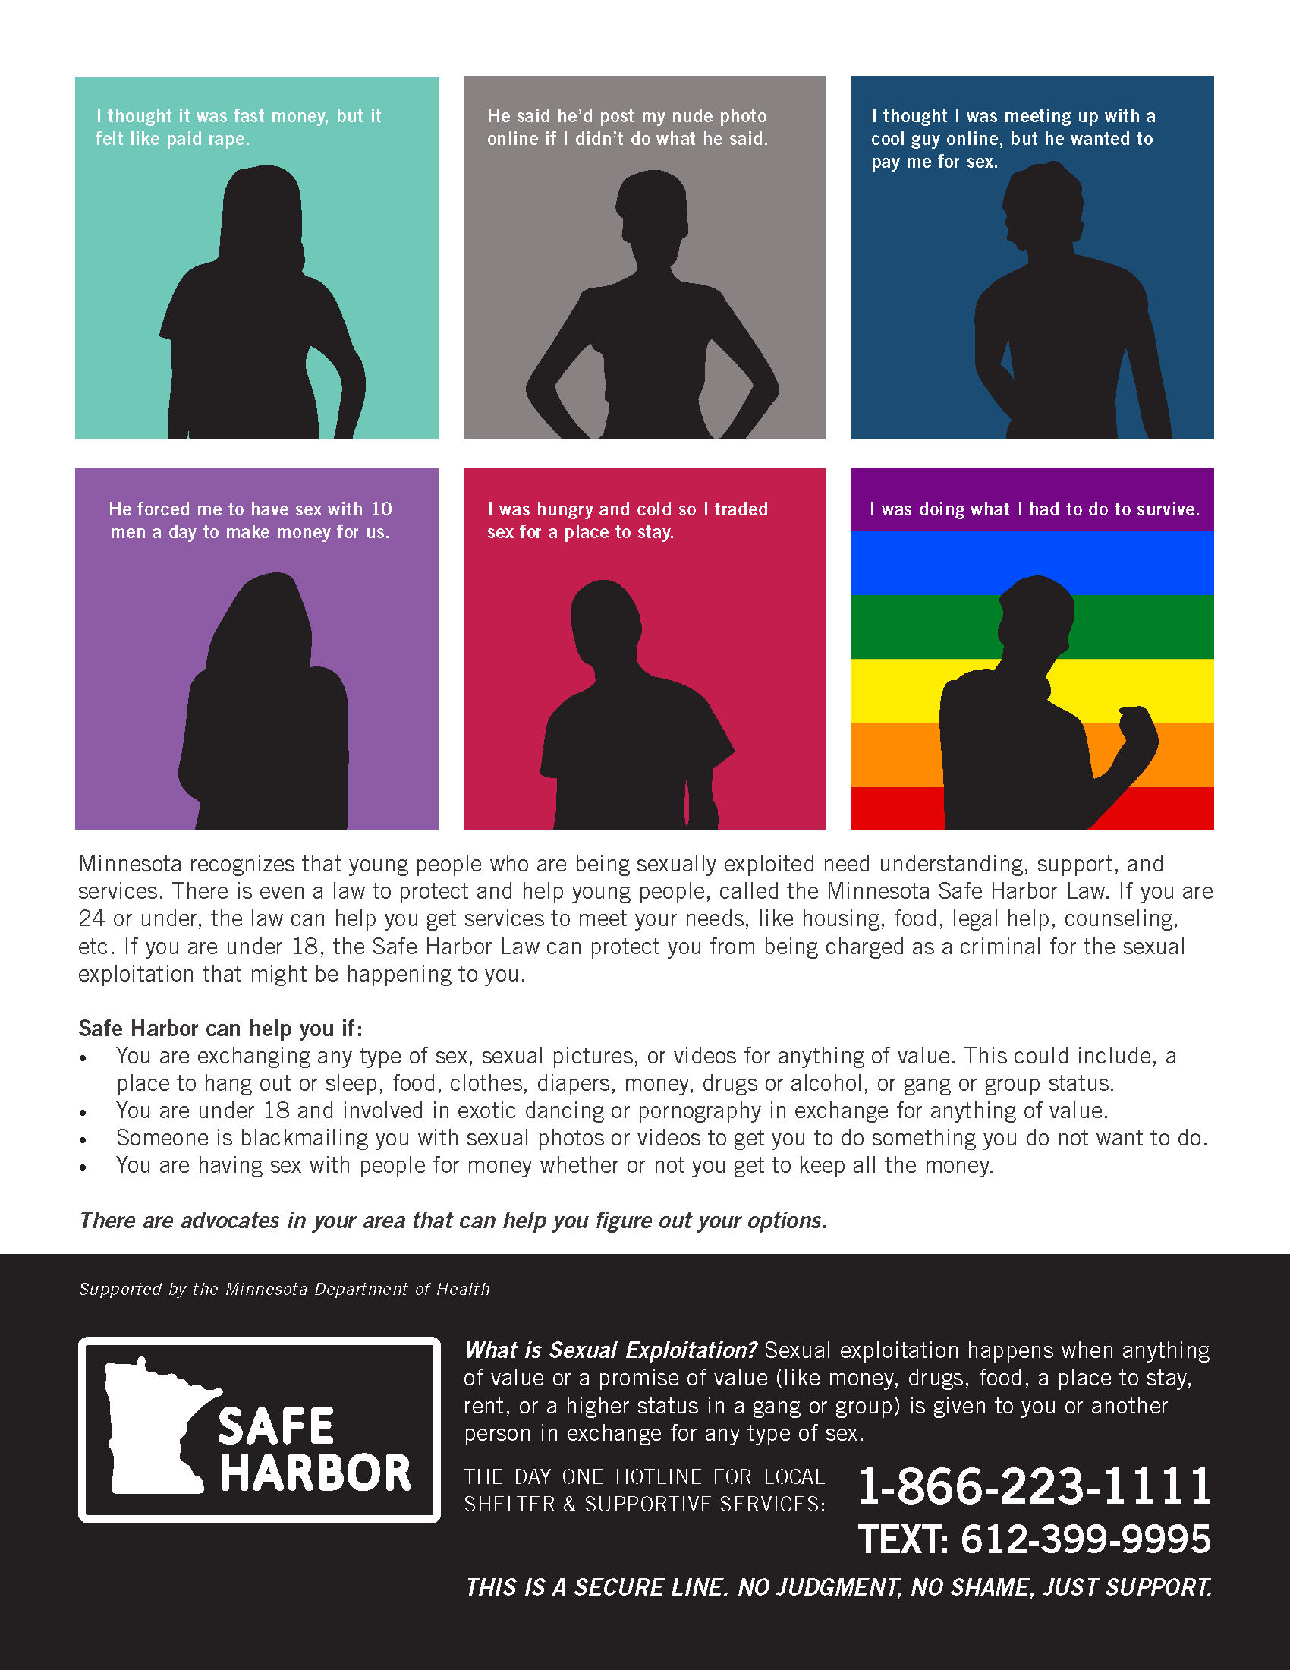
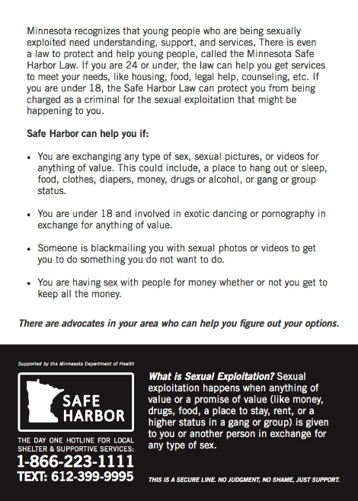
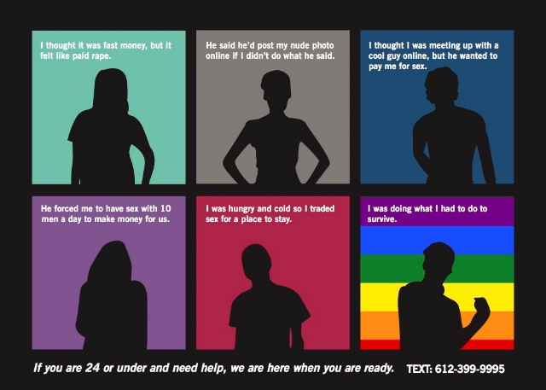
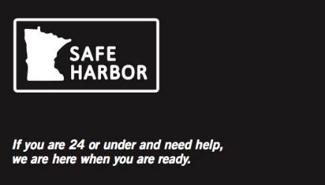
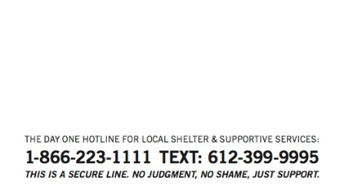
5 X 7 Outreach Card
SAFE HARBOR
PRIMARY OUTREACH
MATERIALS /
Business card size outreach cards (2 versions)
Sticker that will fit on a variety of outreach materials
Primary Safe Harbor Posters (2 versions)
Notes:
You can see some examples in the handout but I also wanted to share some key examples here:
****
NEW SAFE HARBOR YOUTH OUTREACH MATERIALS INCLUDE:
• 28 different fillable/customizable posters that grantees can customize representing imagery and messaging from
youth survivors across the state – including culturally specific posters for LGBTQ, African American, Native, Hmong,
Somali and Latino youth.
• A Safe Harbor 5 x 7 Outreach Card.
• Safe Harbor business card size outreach cards – two versions (one with the sexual exploitation definition and one
without).
• The official Safe Harbor main posters – three versions – grantee fillable version, Day One text and call numbers
version, and a tear off version with Day One text number (these are in addition to the fillable posters noted above).
• Safe Harbor stickers (sized 1 ¼ x 2 ½ -- to be used by grantees on any type of outreach material) that will allow
providers and outreach workers across the state to put a streamlined contact number on any outreach tool/material
with a central number (Day One text line included)
• Safe Harbor silicone awareness bracelets – with a discreet message (SH4Y – which is an acronym for Safe Harbor for
Youth – or you) on the front that advocates can explain to youth, and the Day One text number discreetly placed on
the inside.
• 2-page Safe Harbor handouts for Parent and Professionals.

Slide 12
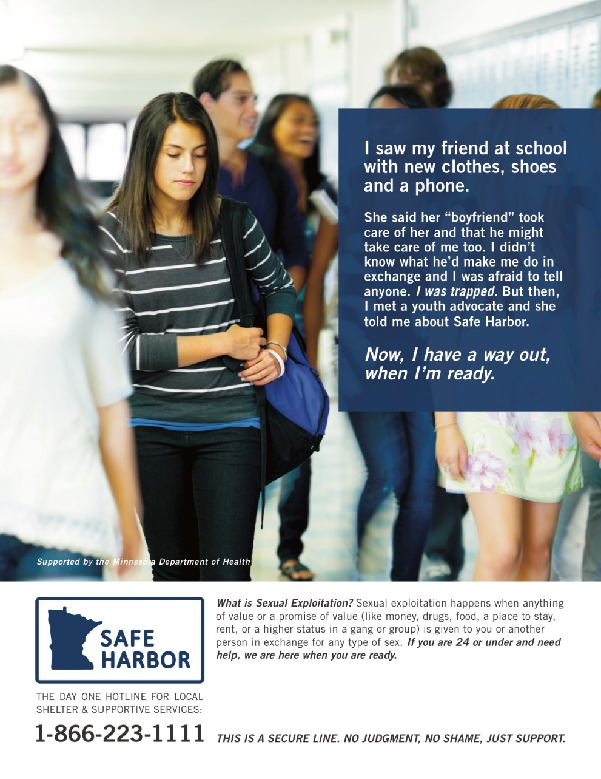
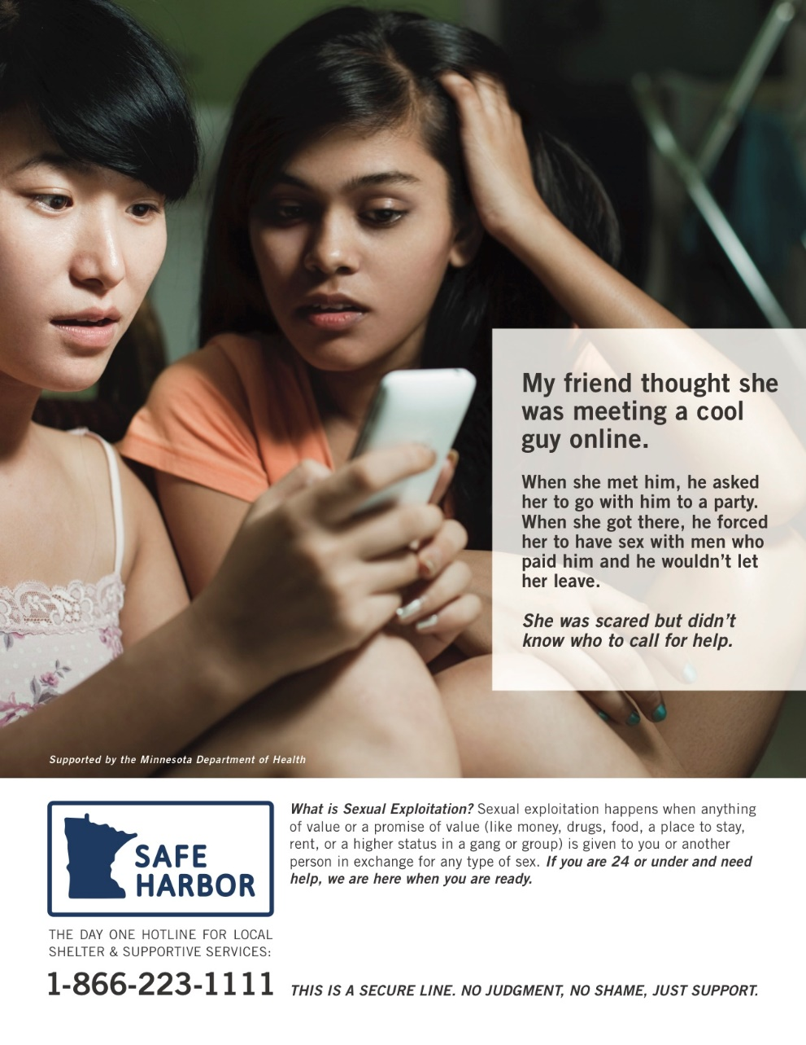
SAFE HARBOR
POSTER EXAMPLES /
Notes:
Many posters include a prevention focus, trying to intervene before the harm has occurred and interrupt the means by which traffickers target youth.

Slide 13
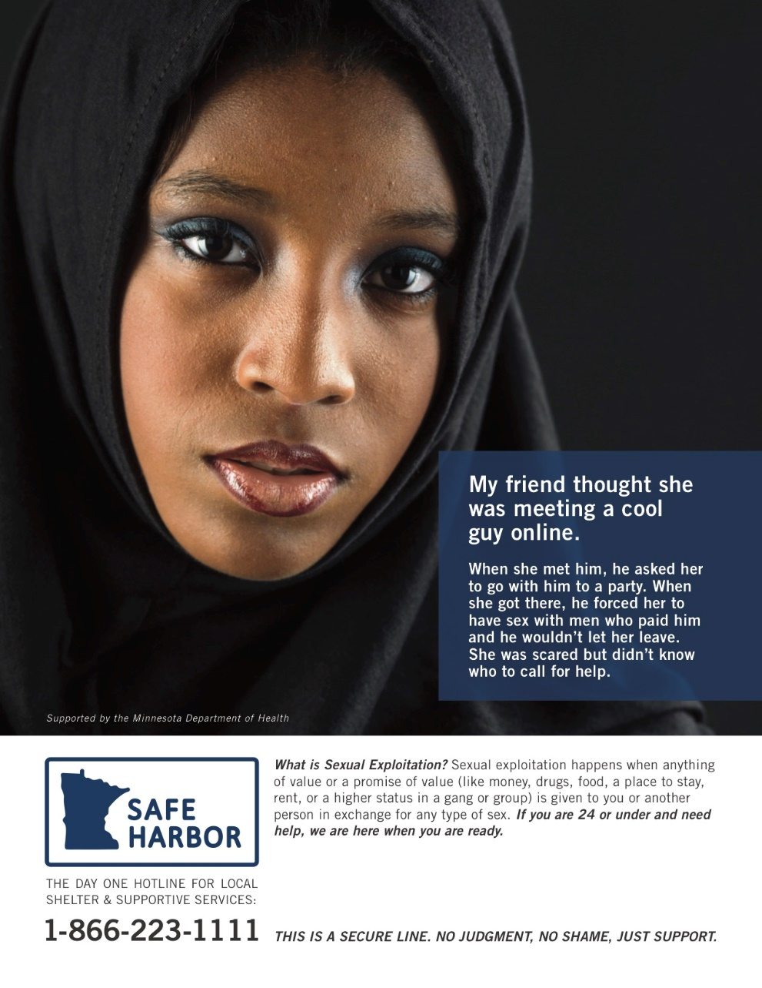
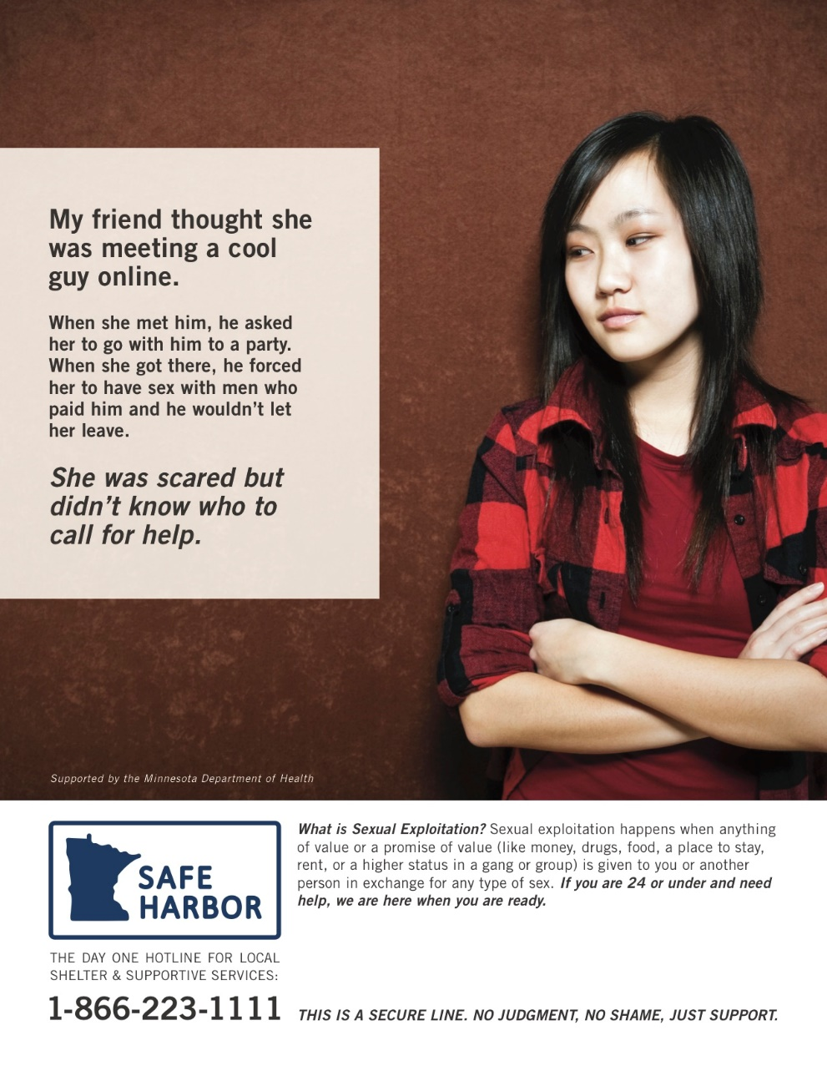
SAFE HARBOR
POSTER EXAMPLES /
Notes:
Heather also worked specific communities to make materials culturally relevant and diverse.
(Advocates in these communities help identify posters and messages that would be relevant and we will be translating them. )

Slide 14
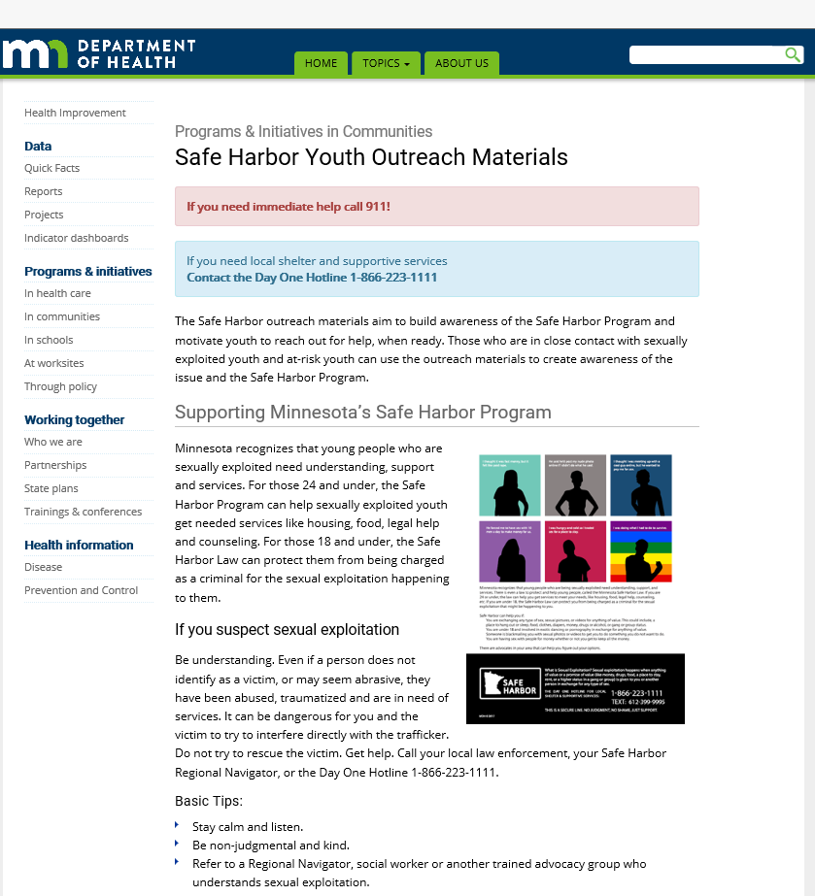
Access Safe Harbor Youth Outreach Materials and Communications Toolkit
MDH Website
http://www.health.state.mn.us/divs/healthimprovement/programs-initiatives/in-communities/safeharbor.html

Slide 15
Resources
Minnesota Human Trafficking Task Force www.mnhttf.org
Voices of Safe Harbor: Survivor and Youth Input for Minnesota’s Model Protocol on Sexual Exploitation and Sex Trafficking of Youth mncasa.org
Safe Harbor website www.health.state.mn.us/injury/topic/safeharbor/
Don’t Buy It Project, Men As Peacemakers dontbuyitproject.org
Not A #Number Human Trafficking Prevention Curriculum for Youthhttps://love146.org/notanumber/

Slide 16
Questions? Thank you! Paula Schaefer paula.schaefer@state.mn.us Brandy Maddox bmaddox@thelinkmn.org Heidi Kopischke hkopischke@thelinkmn.org Trevor Berberick trevor.berberick@childrensmn.org

